Slide 2
Avaya on Avaya: Why Avaya UC/CC and Avaya Networking are Better Together
Alan Hase
Vice President—PLM
Avaya
@AlanKHase

Slide 3
Legacy View of Enterprise Networking
Avaya’s View of Enterprise Networking
NETWORK
APPLICATIONS
&
USERS
APPLICATIONS
&
USERS
Notes:
But, our competition looks at this in a very different way. They look at the network as an entity in and of itself…the applications of a business seem to simply be a component of the network.
[click] We take the opposite view…we take the network user’s view. Applications are user’s lifeblood to business and productivity. The network’s role is to be 100% subservient to the applications of the Enterprise. Every attribute of a network should have a direct relationship to the applications it serves.

Slide 4
Differentiate with Avaya on Avaya
Best In-Class User Experience
Ease of Support
Best in Class Stacking – Improves Voice, Video and Application Performance
Identity Engines
Policy Based Access Control for BYOD
Policy Based Access Control for Avaya Clients
Fabric Connect Edge Networking
SLA Monitoring - Latency, Jitter and Loss Monitoring Agents in Switches and IP Phones
VPFM - Integrated Fault and Performance Monitoring for Voice, Video and Applications
High Touch Technical Support for Top Partners
Ease of Provisioning
Ease of Commerce
IP Office Configuration - Single Command to Configure the Switch for IP Office
Plug n Play and Auto-Provision of Switch Ports for Avaya IP Phones
Policy Based BYOD & Guest Access
Collaboration POD – Fully Integrated UC, Networking and Storage Solution
Single Quoting and Ordering System for UC/CC and networking
Aggressive, Integrated Channel Marketing Programs
Competitive Pricing & Consistent Discounting Offers

Slide 5
Best in Class Experience
Available Today
Up to 18x the performance ensures readiness for real-time applications
Advanced Resilient Stacking ensures always on availability
Identity Engines Policy Based Access Control for BYOD
CY13 Roadmap
ERS3500 Stacking
Fabric Enabled Access
Policy Based Access Control for Avaya Clients
Campus Edge Switch
Backplane Capacity
Gbps
Source: Miercom, 2011 (*Outside of the test set)
¹Source: LANCAT Tool, 2012

Slide 6
Ease of Provisioning
Available Today
IP Office Configuration Script Single command switch config <1 min
Plug n Play with IP Phones Auto-provision ports <1 min
BYOD Support Guest provisioning in <10 seconds
CY13 Roadmap
Collaboration POD
Avaya Integrated Solutions
Ease of Use and Deployment Simplicity
run ipoffice
Notes:
Automatic QoS

Slide 7
Ease of Provisioning Use Case
Scenario: Pinnacle Company has to install 5 different converged IP Office Systems in different customer sites. Using ERS 3500 quick start installation script…
Voice centric installer unpacks equipment
Connects to ERS 3500
Types one command; switch is set up in under a minute
Error free deployments - in minutes rather than hours - without specialized data expertise

Slide 8
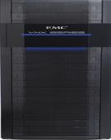
Introducing Avaya Collaboration Pods
^{From Silos to Integrated}
Networking
Integrated Management
and Orchestration
Integrated Support
Compute
Industry leading storage vendor
Delivering storage arrays for Avaya VAR
Industry leading virtualization vendor
Delivering virtualization and VDI software
Industry leading communications vendor
Delivering networking, applications, management & integration
Storage
Integrates network, compute, storage, management and applications as a single solution offering
See live at VMworld booth #1823
www.avaya.com/vmworld2012

Slide 9
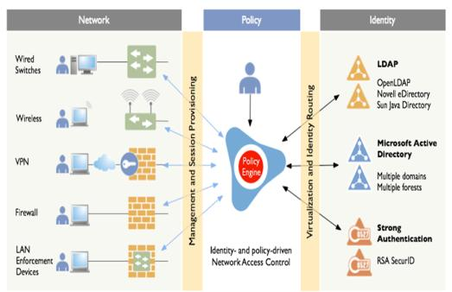
Identity Engines Overview
Powerful Identity-Based Policy Engine
Easy to Use – Deploy a Guest in Less than 10 Seconds
BYOD Support for Employees, Guests, Business Partners, etc.
Unified Wired, Wireless & VPN Access Control
Network Vendor Agnostic
Federated Directory Services (AD, LDAP, Kerberos, etc)
Simple and Affordable Licensing Model
Mobile Collaboration Solution – Aura, One-X, Flare, Identity Engines
NETWORK ABSTRACTION LAYER
DIRECTORY ABSTRACTION LAYER
Guest Access Mgmt
Posture Assessment
Reporting & Analytics
Access Portal
CASE Wizard

Slide 10
Identity Engines Portfolio
Ignition Server
Core Policy Engine
Authenticates and authorizes users and devices based on 802.1x and MAC authentication
Ignition Guest Manager
An application for creating and managing guest accounts by non technical personnel
Ignition Access Portal
Provides inline access for non 802.1x clients
Profiling of user devices & On-boarding
Ignition CASE Wizard
Automates configuration of 802.1x and MS-NAP on Windows PC’s
Ignition Posture
Checks compliance with secure posture based on MS-NAP
Ignition Analytics
Reporting and statistics
Ignition Server
Ignition Guest Manager
Ignition Access Portal
Ignition CASE Wizard
Ignition Posture
Ignition Analytics

Slide 11
Ease of Support
Available Today
Enhanced Service Level Monitoring Agents in 96xx IP Phones, ERS3/4/8K & VSP7K Switches
CY13 Roadmap
SLAMON Agent in ERS5K and VSP9K
SLAMON Server in VPFM

Slide 12
Ease of Support Use Case
Scenario: Apex Company’s most strategic customer is hosting an event where there will be a significant increase in voice and video traffic. With Avaya SLAMon..
Real-time traffic is simulated to proactively measure performance
Potential issues and their root cause is easily identified
Changes are implemented prior to the event
Proactive performance monitoring addresses issues before they arise

Slide 13
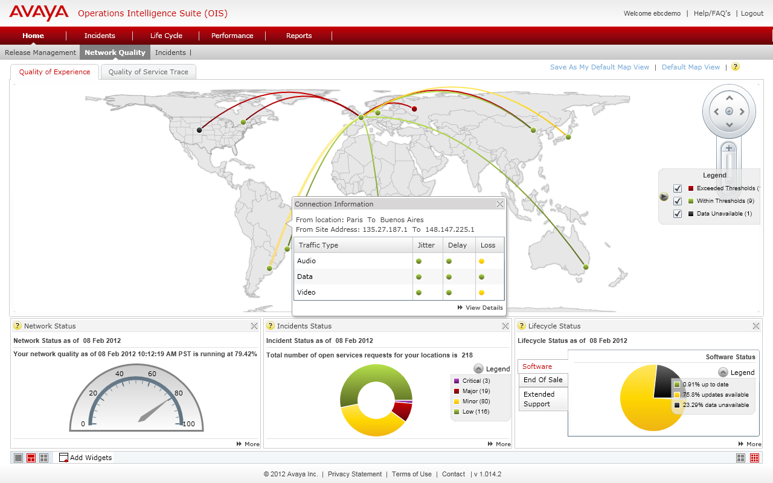
Ease of Support Monitor Application, Voice & Video Quality
Overall Network Performance
Shows network locations on world map
Displays individual site performance as well as the relational performance among sites
Tests the connections for jitter, delay and loss for audio, data and video
Proactively find service-impacting conditions that can be resolved to improve the network performance

Slide 14
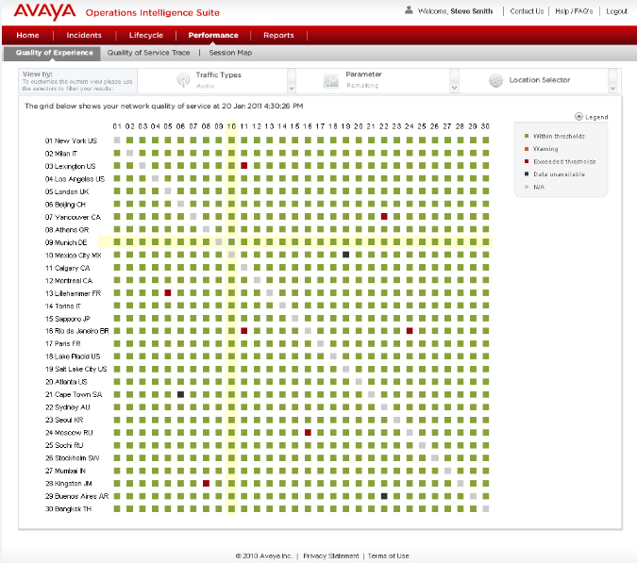
Ease of Support Diagnose Problems
Pinpoint WHY you’re having network issues
Quality of Experience Matrix displays end points and connection details
Green cells indicate that traffic is going from the source to destination correctly
Red cells indicate all traffic going into the site is incorrect
Provides performance factors including delay, jitter, packet loss, remarking, etc.
Displays audio, video, and data queues and associations

Slide 15
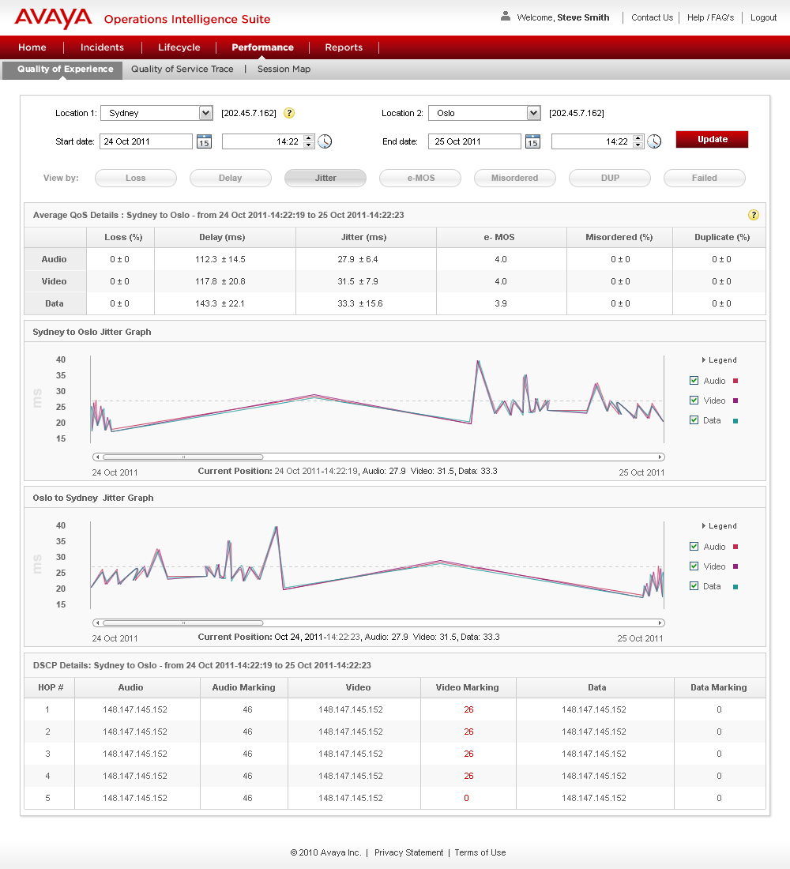
Ease of Support Accelerate Problem Resolution
Solve and prevent chronic issues
Service Level Agreement (SLA) Monitoring provides network quality statistics
SLA Mon tracks all of the packets and identifies where the problem occurs with packet transformation
Runs end-to-end tests and measures results
Traces through network identify performance factors such as remarking
Session maps performs end-to-end call trace showing end points and gateways

Slide 16
Ease of Commerce
Available Today
Aggressive, Integrated Channel Marketing Programs
IP Office and ERS3500 / ERS4800 PDPs
Integrated Quoting and Pricing Tools for UC, CC and Networking Products
CY13 Roadmap
Integrated Ordering System for UC/CC and Networking Products
Consistent Discount Structures
Notes:
Ease of Commerce
Red and Blue systems and tools converging = Simplicity/Commitment
Today:
Single Quoting System for UC and Networking -> January 2012
Solutions pre-tested in Avaya SIL lab
Holistic channel compensation and programs
New programs in 2013 include Data Deal Registration, Grow Right, PoE for free
Future:
Order flow through – enables order flow through for direct and single sap instance for disti
Pricing consistency – normalizing pricing; voice & networking pricing will be consistent; WPP goes away; move to APM – Avaya Pricing Model; In-line with red pricing today (Red – 55% off)
Services Integration -

Slide 17
Recent Press Releases
Rothesay Netherwood School
City of Boynton Beach
City of Taylor, Michigan
Press Release ,December 2012
“We were careful to invest in highly reliable, proven technology that will save us time and money and open up new possibilities for how we deliver services to our citizens. The Avaya team has gone above and beyond my expectations, and I am fully confident we have the best partner for the job.”
Laurie Gagner, Network Manager, City of Boynton Beach
Avaya Solution
IP Office, IP Phones, ERS 4000/5000, WLAN 8100, Identity Engines, Unified Management
Press Release ,January 2013
Press Release ,November 2012
“One of the deciding factors in our decision was the synergy between Avaya’s networking portfolio and Avaya IP Office. We now have a scalable solution that delivers the security, reliability and ease of administration we need, with modern unified communications capabilities that are improving our productivity. Ultimately we’re able to do more with less people and at a lower annual cost.”
Snehal Patel, Technology Director, City of Taylor
Avaya Solution
IP Office, ERS 3000/4000/5000, WLAN 8100,
“Our goal is to build 21st century classrooms with interactive tools that help students learn in new ways. With Avaya, we now have a powerful network that is up to the task and can support the steps we’re taking to improve learning. We are able to get everything we need from Avaya—delivered in one fully integrated package.”
Tammy Earle, Director of Technology, Rothesay Netherwood School
Avaya Solution
IP Office, IP Phones, ERS 4000/5000, WLAN 8100, Identity Engines, Unified Management

Slide 18
@AlanKHase

