Slide 2
APDS Delta Avaya Professional Design Specialist – Networking
Gary Brueningsen
Consulting Systems Engineer – Networking
February, 2013
#AvayaATF
@gbruenin56

Slide 3
APDS – Networking Course Overview
Provide the delta between APDS –Networking 2011/2012 to current
Products
Design Considerations
After completing this course, students should be able to:
Identify and technically describe Avaya Networking products and solutions to customers based on their identified needs
With assistance, design a converged campus solution based on the provided customer requirement
Identify the key Avaya value advantages at a technical sales level in the above converged campus solution design
Specify the technical value proposition (what, why, how) and the associated solution design
Pass the APDS - Networking accreditation exam

Slide 4
APDS – Networking Prerequisites for Delta
Successfully Completed APDS – Networking in 2011/2012

Slide 5
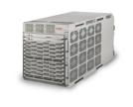
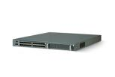
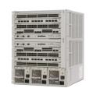
Avaya Networking The Markets We Serve
Secure Mobile
Collaboration
Unified
Branch
Network Management
Avaya Desktop Video Display
Intelligent Edge
VSP 9000
Dynamic Data Center
Flare on iPad
Collaboration Pods
VSP 7000
WLAN 8100
Wireless Sets
SR 4134
ERS 4000
ERS 8000
ERS 5000
VPN Clients
VoIP Desk Sets
AG 2330
ERS 2500
ERS 3500
Customer Care Sets
Third party clients
Notes:
Rather than focus on separate networking and collaboration components, Avaya is focusing on technology solution sets. [click]
For instance, to build the dynamic data center, Avaya starts with carrier grade, field-proven hardware, then employs intelligent technologies that allow a simplified two-tier architecture, point and click virtual networks, and a fully converged collaboration pod. [click]
Now, at access point of the network, the intelligent edge starts with plug-n-play VoIP, in-service maintenance capabilities, high performing wired and wireless access engines, and quality integration between voice and data elements. [click]
At remote locations, the unified branch delivers all-in-one voice and data appliances, unified voice and data quick installation scripts and a flexible range of deployment options.
Now, a secure mobile collaboration solution offers role-based access identity, in-network communication between consumer devices, and simplified VPN for VoIP. [click]
And then to top it off, Avaya uniquely delivers the deployment of an Ethernet fabric across the entire enterprise offering: Improved time to service, the ability to manage performance, and the reduction of configuration errors.
To introduce these solution sets more fully, let’s ground ourselves on where we are at as a market. [click]

Slide 6
Dynamic Data Center

Slide 7
Ethernet Routing Switch Portfolio Family
VSP 9000
Modular
Core
ERS 8800
ERS 8800/8600
ERS 8300
ERS 5000
VSP 7000
Access
ERS 4000
Stackable
ERS 3500
ERS 2500

Slide 8
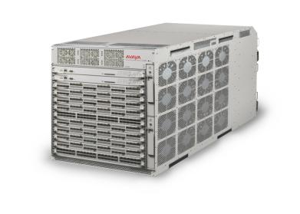
Avaya Virtual Services Platform 9000
Highlights
Fully redundant hardware with no single point-of-failure
Hardened Data Center operating system
Instantaneous re-route
Efficient Layer 2 & 3 network virtualization
Operations-focused features
Delivers high-density 10GbE today
Future-ready for a seamless evolution to 40/100 Gigabit & Lossless
8.4Tbps today and an architecture that scales up to 27Tbps
High density 1/10 Gigabit
Operations-focused features
Scalable mid-plane design
Future-ready for 40/100 Gigabit, lossless, & storage convergence
Notes:
The VSP 9000 is Avaya’s next-generation Ethernet switching solution combining high-performance, high-capacity and high-availability with very high-density of Gigabit and 10 Gigabit Ethernet, with a maximum of 240 ports 10 Gigabit or 480 ports Gigabit Ethernet.
Ideally positioned for the demanding Data Center environment, with a special purpose Carrier grade LINUX based operating system and no single point of failure the VSP 9000 can support 24x365 mission critical operations.
The VSP 9000 has been architected to scale up to 27 Tbps, to support 40 Gigabit and 100 Gigabit Ethernet. The innovative NPU, Network Processing Unit based Route Processor offers extremely efficient packet processing, while allowing for in-life firmware upgrades to support the latest technology development, without hardware upgrades.

Slide 9
Avaya VSP 9000 Release 3.3
SPB functionality
IEEE 802.1aq – RFC6329
Fabric Access Modes (UNI Types)
VLAN Mode w/ Avaya HA(SMLT)
Fabric Interconnect Modes (NNI Types) – Requires 9024XL
Port Mode
MLT/LAG Mode
L2VSN (Any-to-Any)
Unicast w/ Inter-VSN Routing
IPv4 with/without Avaya HA or VRRP
GRT Shortcuts (formerly IP Shortcuts)
Unicast, IPv4 w/ Avaya HA(SMLT) or VRRP
L3VSN (Any-to-Any)
Unicast, IPv4 w/ Avaya HA(SMLT) or VRRP
Operation and Management
IEEE 802.1ag
L2 ping
L2 traceroute
L2 tracetree (ISID)
EDM on-box support
EDM-COM plug-in for off-box support*
* EDM Plug-in for COM available with Release 3.3, additional COM wizards and manager are provided post Rel. 3.3.

Slide 10
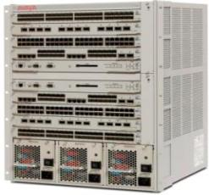
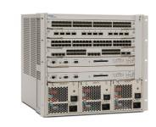
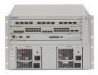
Avaya Ethernet Routing Switch 8800
A refreshed platform delivering enhanced functionality
Fully programmable network processor offers investment protection
Simple software upgrade enables support for Virtual Services Fabric with Release 7.1
Proven technology offering industry-leading resiliency
New 8895SF Switch Fabric/CPU
More powerful and “greener”
Higher capabilities and scalability
Highlights
Fully featured 1/10 Gigabit
Virtualization-enabled
Flexible port configurations
Positioned as a Gigabit aggregation switch with 10 Gigabit scalability
3-slot chassis
6-slot chassis
10-slot chassis
Notes:
The Avaya ERS 8800 delivers high density Gigabit and 10 Gigabit connectivity, combined with simplified network virtualization using Shortest Path Bridging (SPB) and industry unique resilient switch clustering through SMLT and R-SMLT, each recognized and proven technology.
The SPB Virtual Service Fabric is a software only upgrade for installed base customer, providing superior investment protection and a smooth evolution to simplified virtualization of services on the enterprise network.
Further technology evolution can easily and cost-effectively be supported due to the NPU-based Route Switch Processor technology, we also saw with the VSP 9000.
Available in three chassis sizes, with eight, four or two interface card slots the 8800 can support a wide range of deployment models.

Slide 11
Ethernet Routing Switch 8800 8800 is the New-Generation of 8600
ERS 8600 was rebranded as 8800 starting with Release 7.0:
New switch fabric 8895SF
New I/O modules 88xx
R/RS modules no longer available for new purchase
ERS 8800 is NOT supporting "old" traditional 8600 I/O modules, Switch fabrics, power supplies (8001, 8002), and "classic" fan trays:
Requires 8692SF (with 7.0 with SuperMezz daughter board) or (new) 8895SF
Supports only R/RS/88xx modules
88xx modules require Rel. 7.1
High-speed fans required for RS/88xx modules
Supports only 8005, 8004 power supplies:
8004 only with R modules; RS modules require 8005 PS

Slide 12
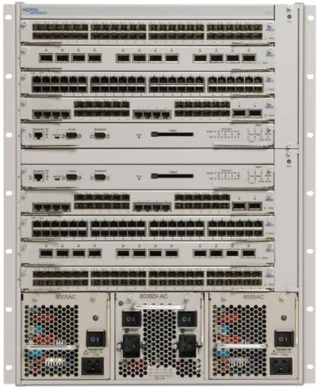
Ethernet Routing Switch 8800 Interface Modules
8812XL – 12-port XFP 10G LAN
8895SF– Switch Fabric and CPU 720-Gbps Architecture
8834XG – 2-port 10-GbE LAN XFP + 24-port SFP, plus 8-port 10/100/1000
8848GT – 48-port 10/100/1000
8648GBRS/8848GB – 48-port 100/1000 SFP
High-speed fan trays
8005AC Dual Input 1500-W PS
8005AC/DC 1500-W PS

Slide 13
Avaya Virtual Services Platform 7000 Overview & Highlights
Fit-for-Purpose for Today
Brings Virtualized Services directly to the Server
Enabling “the cloud” through high performance VM support.
Optimized for iSCSI
Featuring Fabric Interconnect which delivers low latency high throughput 5.12Tbps virtual backplane.
Versatile 1 or 10 Gigabit Ethernet switch designed for the Data Centre server connectivity.
Small form-factor & energy-efficient with front-back or back-to-front cooling options
Future-Ready for Tomorrow
Lossless architecture & Data Centre Bridging-ready to integrate Fibre Channel
Architected for seamless integration of 40 and/or 100 Gigabit
Addressing new market segment of 10 Gigabit for “Top of Rack” in the Data Centre.
Lightning-fast performance with flexible connectivity options.
Supporting up to 256 10Gigabit ports in one virtual chassis.
Highlights

Slide 14
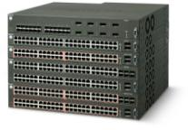
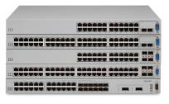
Avaya Ethernet Routing Switch 5000
Scalable solution to empower convergence
Zero-loss, Fail-Safe Stacking
10/100/1000 Ethernet
Power-over-Ethernet
Advanced Quality of Service
10 GIG uplinks
Optimized for iSCSI
Lossless ethernet features on ERS5600
including lossless buffering and Data
Center Bridging.
Integrated Access Control
802.1X with extensions
802.1AB auto discovery for plug and play of Avaya end points
Active/Active cluster for 99.999% reliability in Network Edge or small/medium Core
Enable the Converged Desktop
High-availability locally and to the Core, plus Switch Clustering (SMLT)
Scalable, pay-as-you-grow
Unlimited Lifetime Warranty
Highlights
ERS 5500
ERS 5600

Slide 15
Intelligent Edge

Slide 16
Avaya Ethernet Routing Switch 4000
Scalable convergence solution
Fast or Gigabit to the Desktop, 100FX, SFP, & XFP options
GIG & 10GIG Uplinks
Power-over-Ethernet & QoS
Zero-loss, 320 Gb Resilient Fast Stack
high-speed local switching & Dynamic Layer 3 Routing
Avaya Energy Saver (AES)
Integrated Access Control
802.1X with extensions
802.1AB auto discovery for plug and play of Avaya end points
99.999% reliability for Network Edge
Enable the Converged Fast Ethernet or Gigabit Desktop
Comprehensive Routing & Access Control options
Scalable, pay-as-you-grow
Unlimited Life Warranty
Highlights
10/100/1000 & 10G Switches
10/100 Switches

Slide 17
ERS 4000 Series Next Generation Hardware
New Models
4826GTS-PWR+
4850GTS-PWR+
4826GTS
4850GTS
4550T-PWR+
4526T-PWR+
802.3at PoE+ on all ports
Dual removable power supplies
800 watts PoE (full class 3 PoE)
Faster CPU & larger FLASH
RJ45 console port
Uplink ports
2 x 1/10Gig SFP+ ports (not shared)
2 shared 10/100/1000/SFP ports (gigabit models)
Notes:
The 4500 series includes two models providing 802.3at PoE+ to 24 or 48 ports, combined with two combo ports.
And finally we offer four ERS 4800 switches with 24 or 48 10/100/1000 ports with or without PoE+ and combined with two shared SFP and two SFP+ ports.

Slide 18
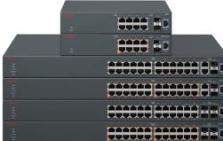
Avaya Ethernet Routing Switch 3500
Cost effective Fast Ethernet and Gigabit Ethernet to the desktop
Small fan less models for quiet operation (retail, hospitality)
Virtual backplane up to 80 Gbps
PoE+ support
Unlimited Lifetime Warranty
Enterprise-class features and functionality at SME price points
Software-based on the ERS 2500
Price points up to 50% lower than models in existing portfolio
Consistent Value Proposition with existing ERS portfolio
Best-in-class stackable chassis
24-port models only, enabled in v5.1
Models with all ports PoE+
Always-on networking
Simplified edge operations
Wide range of security features
Positioned as an SME / branch switch
Highlights

Slide 19
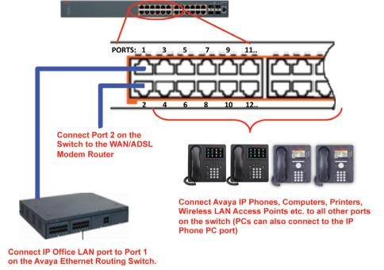
ERS 3500 IP Office Installation Script
Supports a CLI command that provides fast setup using best practices configuration in a UC incorporating Avaya IP Office and Avaya IP Phones
At “35xx-PWR+#” prompt, type the required CLI command:
run ipoffice (Fully automated setup script)
run ipoffice verbose (User prompted setup script)

Slide 20
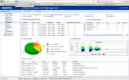
Main Components for WLAN 8100
WLAN Access Point 8120
Provides wireless access to mobile devices
WLAN Controller 8180
Manages and Controls WLAN 8100 Access Points
WLAN Management Software
To plan, configure, deploy, and monitor WLAN 8100
WAP 8120
802.11n
Dual radio
8120 – internal antennas
8120E – external antennas
WC 8180
WC 8180 -16L
Support for up to 512 APs
Lower cost option for small branch deployments
Support for 16 APs
WLAN Management Software 8100

Slide 21
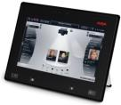
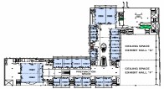
WLAN 8100 What’s New
WLAN 8100 Infrastructure
WAP 8120
WAP 8120-O
External Antennas
WLAN Controller 8180
Management
WAP 8120/8120-E
Dual radio, 802.11n
8120-E: Plenum rated
70° directional
180° omni-directional
WC 8180 – 512 AP's
WLAN Management Software 8100
WC 8180 – 256 AP's
Outdoor 802.11n AP
WC 8180 -16L - 16 AP's
Optional Wireless Network Services
Voice/UC
Video
E-911
Guest Management
Network Access Control
Location Services
Infusion pump
X
Avaya 3641/3645 IP Wireless Phones
Avaya Flare ADVD A175
E-911 VoWLAN integration
Unified Wired/Wireless Ignition Guest Manager
IT Compliance Identity Engines
Real Time Location Tracking
Notes:
The portfolio today comprises two wireless LAN controllers, a 64 license controller that can scale to support 256 access points and a 16 license controller for smaller enterprise deployments and one 802.11n dual radio access point. The Wireless LAN Management Software provides a graphical user interface application suite that is used to plan, configure, deploy and monitor the wireless LAN and users. The management software is also integrated into Avaya Unified Communications Management which provides unified management across wired and wireless networks.
The portfolio supports a broad range of wireless services including voice, unified communications and video. We have real time location services, enabling customers to track any Wi-Fi enabled device within the coverage area of the wireless LAN network.
We have a partnership with AirTight Networks for customers requiring advanced wireless intrusion detection and intrusion prevention capabilities, specifically for customers such as government agencies or the Department of Defense.
We have a comprehensive guest management offering, with Avaya’s Identity Engine Guest Manager solution. Front desk personnel can create unique user ID’s and passwords for each visitor accessing the wireless network, providing secure, convenient network connectivity for guests and temporary users.
Wireless LAN 8100 release 1.0 was introduced in August 2010 and included complete 802.11n solutions comprising controllers, access points and management software. It provided a wireless LAN solution optimized for voice and video.
Release 1.1 in June 2011 introduced new hardware, a plenum rated access point and external antennas and included many software enhancements.
Release 1.2 was introduced in April 2012 and introduced an outdoor 802.11n access point, the Wireless LAN Access Point 8120-O that allows customers to extend wireless coverage outdoors.

Slide 22
Avaya WLAN 8100 Access Points & Antennas
Release 1.0
Release 1.1
Release 1.2
Rel 3.0
8120
Dual Radio
802.11 a/b/g/n
Internal Antenna Only
2x3 MIMO
300 Mbps per radio
Dual 2.4/5.0 Ghz
1 x 10/100/1000
8120-E
Dual Radio
802.11 a/b/g/n
Ext Antenna Required
2x3 MIMO
300 Mbps per radio
Dual 2.4/5.0 Ghz
Plenum Rated
1x 10/100/1000
8120-O
Ruggedized Dual Radio
802.11 a/b/g/n
With Outdoor Antenna
2x3 MIMO
300 Mbps per radio
Dual 2.4/5.0 Ghz
1 x 10/100
-30 to +50 Celsius
IP-67 NEMA Rating
8120-LC
Low cost AP
Dual Radio
802.11 a/b/g/n
2x3 MIMO
300 Mbps per radio
Dual 2.4/5.0 Ghz
1 x 10/100/1000
Release 1.1
Release 1.1
Avaya WLAN 8100 External Antennas
70⁰
Indoor/Outdoor
802.11n optimized
Reverse SMA Connector
IP-67 NEMA Rating
Dual-band MIMO
3 Elements
3’ Cable
180⁰
Indoor/Outdoor
802.11n optimized
Reverse SMA Connector
IP-67 NEMA Rating
Dual-band MIMO
6 Elements
3’ Cable

Slide 23
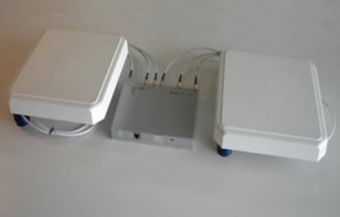
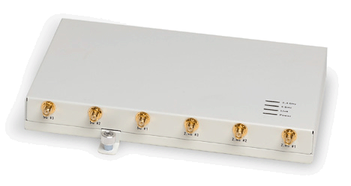
WLAN Access Point 8120E
Plenum rated
Can be installed above ceiling
External antenna support
UL2043 compliant
AP has metal housing
AP has no integrated antenna
Same specifications as AP 8120
Except DFS channels disabled in 1.1
Notes:
Can you explain the difference with the new access point, the 8120E?
Yes, the 8120E increases deployment flexibility as it can be mounted out of sight above a ceiling. It is built to connect to external antennas, which are then located in open air space below the ceiling.
The 8120E and the cables are compliant with UL2043 plenum rating standard. This is the standard that supports installation of equipment in environmental airspaces such as areas above suspended ceilings.
The 8120E has the same specification as the 8120, with the exception that DFS channels are disabled for the moment.
What is DFS?
DFS is the Dynamic Frequency Selection, a mechanism to allow unlicensed devices to share the radio spectrum with existing radar systems without causing interference. Certain bands in certain countries require the ability to detect radar and subsequently avoid the use of that channel, in order to be useable by Wi-Fi equipment.

Slide 24
WLAN 8100 Product Offering R1.2 Outdoor AP Features
High performance, Outdoor 2 radio 802.11abg/n AP
Delivers aggregate data rates up to 600 Mbps.10/100/1000 Gigabit Ethernet connectivity
Designed for harsh environments ; certified IP-67 protection; AP 8120-O uses a sealed water-proof and dust-proof enclosure
Ships with 180 DEG Ext antennas and mounting kit as well as PoE injector, surge protector & lightning arrestor.
Co-exists and works as part of the WLAN8100 system (WC8180, AP8120, AP8120-E)
Independent profiles for outdoor AP (since not all parameters are common between AP8120(E) and AP8120-O
Operation Temperature- -40 to 60℃
Humidity 90% or less; Waterproof IP67 – fully hardened
Notes:
The access point 8120-O is a high performance outdoor 802.11n access point designed for harsh environments. It contains the same radio configuration as the 8120 access point. Each radio also supports 200 simultaneous associations with support for 32 virtual access points or SSID’s, 16 on each radio.
Security is ensured with 802.11i/WPA2 and an encrypted control plane.
The AP 8120-O draws the same power as the 8120 and also only requires hardware installation as all configuration is performed on the wireless controller.

Slide 25
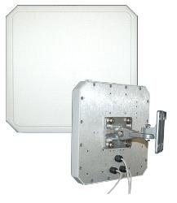
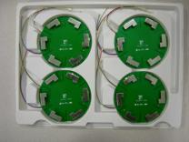
8120E External Antennas
Two external antenna options
70° Dual mode, directional 3 elements
180° Dual mode omni-directional 6 elements
Additional antennas planned
Indoor/outdoor deployment of 8120
Outdoor includes 3ft pigtail cable
Extender kit offers 10ft cable
Various mounting options
Indoor: Ceiling and pole mount
Outdoor options: Pole and wall mount
Full band coverage for 802.11 b/a/g/n
3 Element Directional Antenna
6 Element Omni-Directional Antenna
Notes:
What kind of external antennas are available with the 8120E?
There are actually two different external antennas. There is a directional 70 degree dual mode antenna and there is a 180 degree dual mode omni-directional antenna with six elements.
There is a three foot pigtail cable and a ten foot extender kit that allows these antennas to be operated indoors or outdoors.
Being able to deploy external antennas obviously gives you several benefits:
Planners can choose an antenna pattern that meets coverage requirements while allowing for convenient AP placement and installation.
External antennas allow planners to optimize coverage by being able to direct available energy to where it’s needed and deliver higher available data rates to user concentrations.
Perimeter access points outfitted with directional antennas can focus energy inwards and increase security by preventing signal leakage outside the office.

Slide 26
New WLAN 8100 R2.0
Unifying Wired and Wireless at the Network Core
Embedded WLAN switching in ERS
Exhaustive data scaling
Retains centralized control for ubiquitous user mobility
Low total cost of ownership
Optimized for UC and video
Granular QoS and traffic control
Unified Access r1.0 delivers first unified wired/wireless solution
Integrates WLAN 8100 r2.0 and ERS 8800 r7.2
Wireless forwarding capability embedded in ERS 8800 (application)
WLAN 8180 for management/control traffic only (virtualized in the future)
Additional enhancements
512 AP’s per WC (up from 256)
Multicast video enhancements
Client load-balancing
Highlights

Slide 27
WLAN 8100 Definitions
Local VLAN
Traditional 802.1Q VLAN, identified by a <vid> in the switch.
Mobility VLAN
Assigned to a mobile user by a AAA policy, identified by a unique name
Access and mobility tunnels will be made members of this VLAN by the control plane
In unified networks, wired and wireless users can be assigned to the same named VLAN
Remote VLAN
Provides connectivity to a roamed user in the visited network
Created on the visited network switch to extend a mobility VLAN from a remote switch in the home network
VLAN Mapping
Bridging the wired and wireless segments by tying a mobility VLAN to a local VLAN in some wireless enabled switch in the network
VLAN Server (Host Network)
Provides access to a mapped mobility VLAN through mobility tunnels for remote switches
VLAN Client (Visited Network)
Gains access to a mapped VLAN from a remote location through mobility tunnels
Notes:
The Wireless LAN 8100 is made up of various networking parts and areas defined by the local switching infrastructure as a traditional 802.1Q VLAN.
A mobility VLAN is assigned to a mobile user by a AAA policy and is identified by a unique name. Access and mobility tunnels will be made members of this VLAN by the control plane to provide seamless access to this VLAN for the mobile user. In unified networks, wired and wireless users can be assigned to the same named VLAN.
A remote VLAN provides connectivity to a user roamed to a remote network and is created on the visited network switch to extend a mobility VLAN from a remote switch in the home network.
VLAN mapping provides bridging between the wired and wireless segments by tying a mobility VLAN to a local VLAN, through a mobility tunnel in some wireless enabled switch in the network.
A VLAN server on the host network provides access to a mapped mobility VLAN through mobility tunnels for remote switches.
A VLAN client on the remote/visited network gains access to a mapped VLAN from a remote location through mobility tunnels.

Slide 28
Other 8100 Applications Advanced Security and Planning
Security and user authentication
All popular authentication types and security models supported
WPA2, WPA/PSK, 802.1x, WEP and proactive key caching
AES and 3DES encryption
RADIUS VSA’s (vendor specific attributes) supported
Overlay partnerships for advanced WIDS/WIPS
AirTight (Release 2)
RF planning and site survey
Ekahau

Slide 29
Network Management

Slide 30
Network Management Applications
VPFM
Multi-vendor network discovery, root cause analysis, network topology, maps
COM
Configuration and element management
IP Flow Manager
Multi-vendor IPFIX collection an, analysis, and reporting
VPS
Provides visibility, validation, provisioning automation, & reporting in virtualized datacenter environment
Visualization
Performance and
Fault Manager
Configuration and
Orchestration Manager
IP Flow Manager
Virtual Provisioning
Service

Slide 31
Intelligent Edge

Slide 32
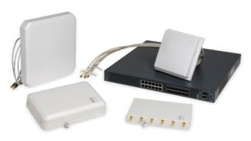
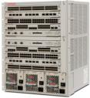
What’s the Differentiation?
Fit-for-Purpose Today and Future-ready for Tomorrow
Scalability
Allows for scaling from 256 AP’s to 512 AP’s with the ERS 8x00 as wireless switching platform
Performance
Reduced latency results in improved voice and video performance
Investment protection
Simple software upgrade takes a customer with an ERS 8x00 from an overlay to a fully integrated solution, providing a long term TCO advantage
Extending wired/wireless integration to the edge
Resiliency/Reliability
Leverage Ethernet infrastructure native resiliency
Cloud-ready
Simple software upgrade eliminates WLAN controller
Unified Access r1.0
WLAN 8100 r2.0
ERS 8800/8600 r7.2

Slide 33
Secure Mobile Collaboration (aka: Access Control)

Slide 34
Rapid Evolution of Mobile Edge
100 000
350 000
75 000 000
800 000 000
1 200 000 000
Android apps
iPhone apps
Tablets in 2012
Smartphones
Social Media Users
Tablet market $45B by 2014 – Yankee 2011
50% Enterprise users interested in or using consumer applications – Yankee 2011
Smartphone app revenue to triple by 2014 – Yankee 2011
TIME’s Person of the Year: YOU

Slide 35
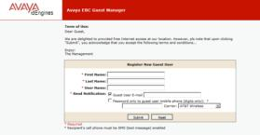
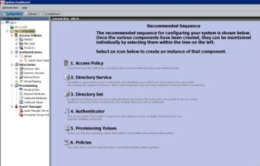
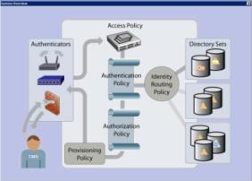
Avaya’s BYOD Solution
Identity-based
Network Access Control
Secure
Network & Device security
Scalable
Future-proof
Optimized
For collaborative, real time applications
Notes:
Higher education have experienced BYOD for quite some time now, however the impact of BYOD is also felt on enterprise wireless networks. Smart devices today have the processing power of laptops from just a few years ago and every new generation is faster and more bandwidth-hungry than the last.
The number of wireless devices on enterprise networks is increasing at an amazing pace. Today’s average enterprise network user carries three to four wireless devices, many of which are capable of processing high-quality, real-time applications such as video conferencing. Most wireless networks were simply not designed to cope with this kind of demand.
It is essential that the IT department has complete visibility, control and management over who is accessing the corporate network, when and what they are doing. Identifying, granting the appropriate access and monitoring these devices can be a significant expense and can cause IT departments regular headaches. Allowing managers to quickly and efficiently add devices to the network and control the access level for devices is critical in keeping the network running smoothly.
Every wireless and wired network needs strict network access control (NAC) and an ability to scale the breadth of that control.
The applications running on BYOD devices, such as tablets, are different than the applications that run on PC devices. There are more multimedia and collaborative applications running on these mobile devices and their capabilities will keep growing over time. Guaranteeing Quality of Service (QoS) for these devices is critical for businesses that want to realize the full benefits of the BYOD revolution. The tools to set traffic rules and prioritize network flow to ensure optimal QoS on mobile and smart devices is critical to any IT manager. The ability to assign different devices to specific service classes reduces the risk of service interruption and assures high-priority users receive the quality of service they expect.
The top concern for IT managers in supporting BYOD is security, based on an IAUG survey. If equipping enterprise networks to handle increasing and revolving number of wireless devices wasn’t challenging enough, every new device now brings with it the possibility of malware, viruses and other programs that could damage or disrupt the corporate network. As wireless networks are open by nature, they are naturally susceptible to piracy by users outside the enterprise, which can lead to performance degradation and security breaches.

Slide 36
Authenticated Network Access
Avaya Identity Engines Portfolio
Identity and Network Access Control
Corporate Directories
Identity Engines
Unified wired and wireless access
Enterprise
WLAN
Enterprise LAN
Internet and VPN
BYOD and Guest access management
Notes:
Avaya Identity Engines portfolio provides centralized, policy-based network access control. It is an Identity and Network Access Control solution that provides best-in-class policy management and role-based access across wired, wireless and VPN networks. It is also important to note that it is a true vendor-agnostic solution and as such supports networking infrastructures and identity stores from any vendor. As an open standards solution, it supports all major standards including 802.1x, RADIUS, VLAN’s and Microsoft NAP.
Identity Engines interworks with Avaya and third party network devices that support 802.1x and will help you open doors with any non-Avaya customer.
We’re seeing opportunities for this product grow as the number of employee owned devices like smart phones and tablets increase on the networks.
It delivers an enterprise-wide guest management system, ensuring safe access to guest users. It also provides full reporting capabilities to keep in alignment with corporate regulations.

Slide 37
Role-based Access… with Identity Engines
IF (identity = HR employee)
AND IF
(device = corp laptop)
AND IF
(medium = wired)
THEN GRANT
FULL ACCESS
Identity Engines
Role-based Access
Case 1
Employee with corporate laptop
IF (identity = HR employee)
AND IF (device = personal iPad)
AND IF
(medium = wireless)
THEN GRANT
LIMITED ACCESS
Case 2
Employee with personal iPad

Slide 38
Role-based Access… with Identity Engines
IF (identity = HR employee)
AND IF
(device = corp Windows PC)
THEN IF
(Complaint with reqs for Firewall + Anti-Virus + OS Updates)
GRANT CORPORATE ACCESS
Identity Engines
Posture with
MS-NAP
Case 1
Employee complying with security health policy
IF (identity = HR employee)
AND IF (device = corp Windows PC)
THEN IF
(NOT-complaint with reqs for Firewall + Anti-Virus + OS Updates)
ISOLATE USER ON A REMEDIATION NETWORK
Case 2
Employee NOT complying with security health policy

Slide 39
Identity Engines Modules
Ignition Server
Ignition Server
The core application of the Identity Engines portfolio
Required for any deployment either as a single server or a High Availability pair of servers
Authenticates and authorizes users and devices based on 802.1x and MAC authentication
Ignition Guest Manager
An application for creating and managing guest accounts by non technical personnel
Ignition Access Portal
Provides inline access for non 802.1x clients
Performs profiling of user devices
Ignition CASE Client
Automates configuration of 802.1x and MS-NAP on Windows PC’s
Ignition Posture
Checks compliance with secure posture based on MS-NAP
Ignition Analytics
Reporting and statistics
Ignition Guest Manager
Ignition Access Portal and CASE Wizard
Ignition Posture
Ignition Analytics
Third-party logos, images and registered trademarks belong to the respective owners. Avaya is not an owner or licensee of the same
39
Notes:
Currently there are five products that make up the Identity Engines portfolio, all of which are software based. The Identity Engines Ignition Server is the centralized policy engine that performs authentication and authorization for clients attempting network access. This product is the core component within the solution. It is important to note that this core application is a required component and must be deployed in order to run the solution. This is in contrast to the other products which are considered additional applications, they provide enhanced but optional functionality. The optional components include:
The Ignition Guest Manager, which allows non-technical personnel such as front desk staff, employees or even the guest themselves to create temporary guest accounts for visitors.
The Ignition Access Portal functions as a captive portal with the ability to authenticate and provide access to users that do not have 802.1x functionality, or if it is not configured on their devices. In addition, the Access Portal provides device profiling to fingerprint user handheld devices in order to be able to apply access policies that take the device characteristics into consideration when granting network access. The Access Portal is provided with a CASE Client that may or may not be deployed in conjunction with the Access Portal. The CASE Client is a dissolvable client designed for fast deployment of 802.1x and MS-NAP on Windows machines.
The Ignition Posture performs device health assessments for managed users to ensure endpoints comply with security policies. Windows is the platform most targeted by malicious security threats. Identity Engines leverages the Windows NAP (Network Access Protection) built-in capability for delivering comprehensive posture checking in a clientless fashion. The Ignition Analytics which delivers at-a-glance reports, highlighting data such as user info, failed authentications, usage summaries etc.
This also showcases many of the business problems solved by the solution.
Identity Engines help organizations to adhere to regulatory compliance needs.
It offers secure guest, visitor and contractor access. It can collapse existing triple A servers into a single deployment to enforce corporate governance policies. It provides centralized policy management to improve and eliminate policy distribution costs. It allows organizations to compartmentalize the network to improve resource utilization and reduce attack surfaces.
Identity Engines allows organizations to implement a standards-based Network Access Control (NAC) solution and can reduce cost of change.

Slide 40
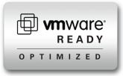
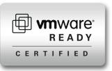
Identity Engines Ignition Server
Centralized, standards-based policy engine.
Vendor Agnostic
Highly-available AAA appliance for identity-based network access control.
RADIUS integration with all enterprise network equipment.
Quick and deep integration with major directories.
Detailed logging and troubleshooting capabilities.
Hitless upgrades where appropriate.
VMware virtual appliance with support for VMware 4.x and 5.0

Slide 41
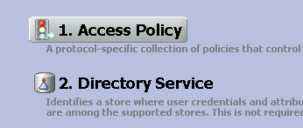
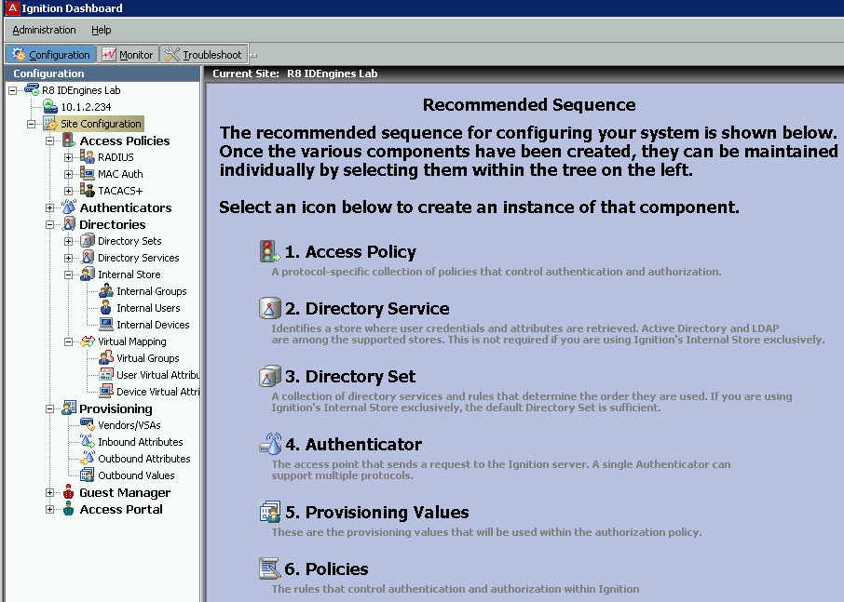
Identity Engines Ignition Dashboard
MOUSE HOVER and CLICK

Slide 42
Identity Engines Ignition Dashboard
Dashboard
Ignition Dashboard is the front end GUI of the Ignition Server
Light weight Java application for Windows
Does not require a dedicated server
Configuration
This view allows the administrator to create, view or alter configuration information for authenticators, directories, local store, virtual mapping, provisioning and access policies to authentication and authorization
Monitoring
Monitors the stats and health of the system. Also provides highly detailed logs on access, system and security information
Troubleshooting
Tools to test your network access and integration with the corporate directories

Slide 43
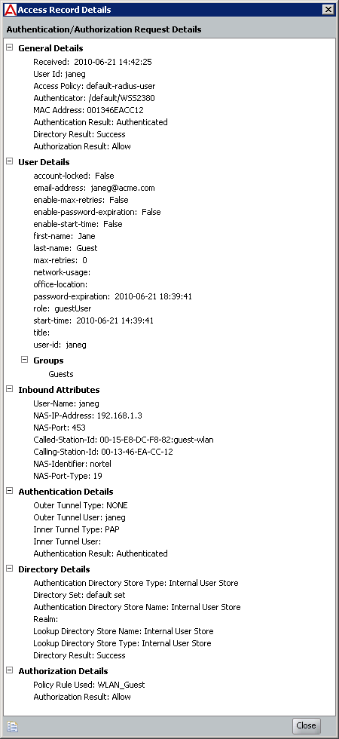
Identity Engines Granular Policy Engines
Extensive access Logs for tracking and audit
Identity Engines through the policies, basically answers the question: Are you one of mine?

Slide 44
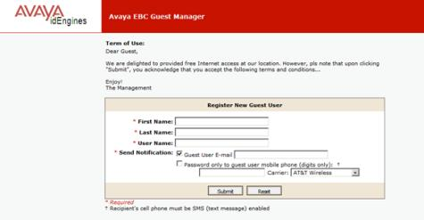
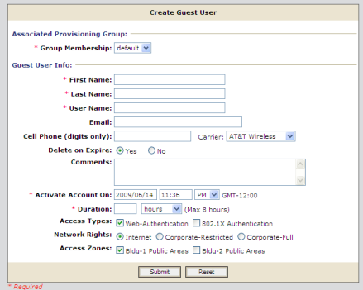
Identity Engines Guest Manager
Guest Manager is a web app that lets non-technical staff create and manage temporary network accounts for visitors.
Front desk staff
Employees
Visitor self-service
Web-based UI automates provisioning / de-provisioning under 30 seconds
Eliminates calls to IT / Tech Support
Activation options
Immediate activation
Future activation
Account duration time
Activate on first login
Choose any access method to implement: wireless, wired, location etc.
Track Users: Guests, Consultants, Contractors.
Notes:
The Identity Engines Ignition Guest Manager is a Web application that front desk staff use to create and manage temporary network accounts for visitors. In today’s environment, the network is no longer only for employees, so organizations must be able to provide secure access for guests, consultants and contractors. Identity Engines allows creation of secure guest accounts that automatically expire after a chosen time period, while only allowing access to what they need.
The front desk employee can create guest accounts within 30 seconds; these accounts can be used over wireless, wired and VPN access. The Guest Manager is designed to be used by front desk personnel, employees or guests themselves.
Users and administrators are also tracked so that the organization can view who created the accounts, how long the accounts will be valid for and what users access during their sessions.
As accounts can be created within seconds, it frees up IT staff time so network administrators can concentrate their efforts on critical tasks.

Slide 45
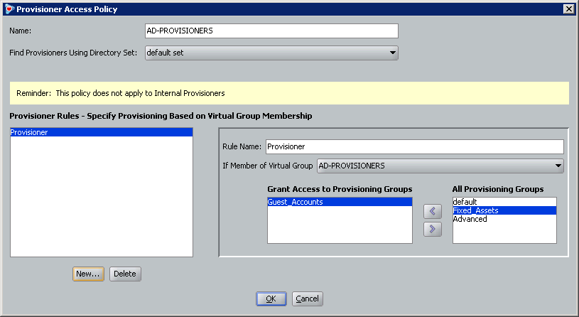
Identity Engines Guest Manager Provisioners
Option (A) – Internal Store
Create provisioner accounts from within Guest Manager
Simple username + password access
Option (B) – Single Sign-On
Create Ignition Server policy to allow external credentials (ex. Active Directory)
Tie AD users or groups to provisioning templates

Slide 46
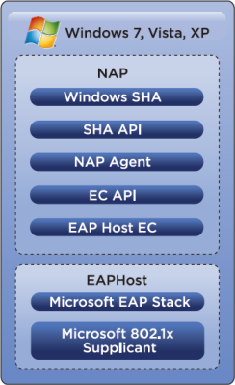
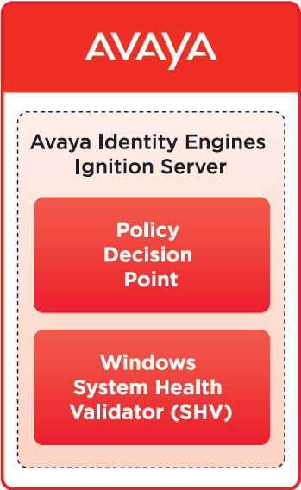
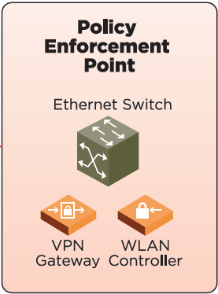
Identity Engines Microsoft NAP

Slide 47
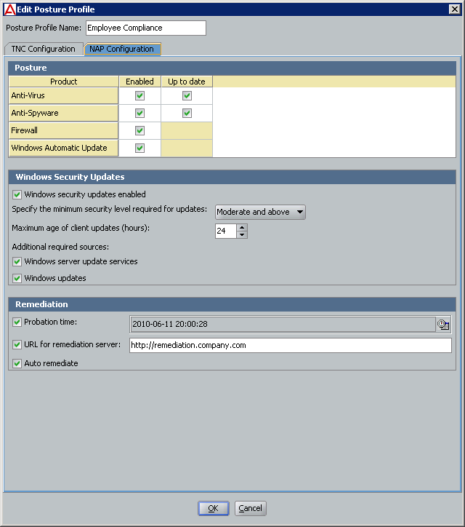
Identity Engines Ignition Posture
A Clientless solution
Identity Engines Ignition Server can require that the health and security of end-user PCs be checked before it is allowed it to connect to the network
Posture policies can also auto-remediate common problems.
Uses Microsoft NAP
Embedded System Health Agent and Enforcement Client Windows XP SP3 and higher
Single license on Ignition Server to enable MS-NAP integration

Slide 48
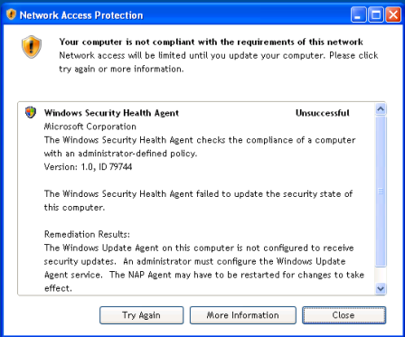
Identity Engines Ignition Posture
User Notification
Clear notification to end-user on access status.
Auto-remediation capabilities.
‘More Information’ to provide end-user with explicit details on what to do next (step-by-step instructions, host s/w etc…)
Full details in Audit Logs.
Ignition Dashboard Posture Rule

Slide 49
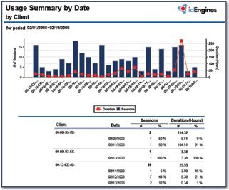
Identity Engines Ignition Analytics
Identify device usage - Who are your top users?
Create audit trails – Look for trends of usage, users, and devices.
Increase visibility into activity level over time, identifying peak usage, lowest usage.
Deliver flexible reporting formats for Ignition Server Reports Administrators and Report Users: PDF, HTML, RTF and XLS file formats.
Supports both customized and pre-canned reporting.
Notes:
The Identity Engines Ignition Analytics is a powerful reporting application that presents the Ignition Server authorization and authentication information in a variety of summary and detailed reports. Ignition Analytics adds reporting to the Ignition Server by enabling automated data retrieval and report generation. As such, it provides increased visibility into network activity and helps to facilitate compliance with corporate regulations.

Slide 50
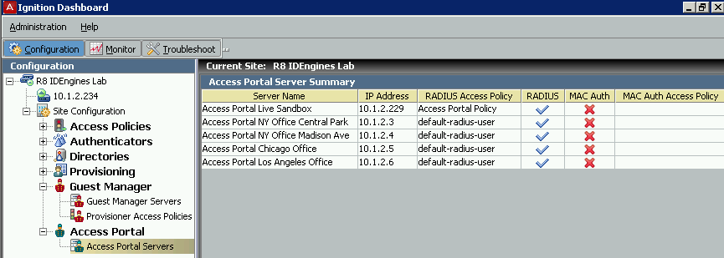
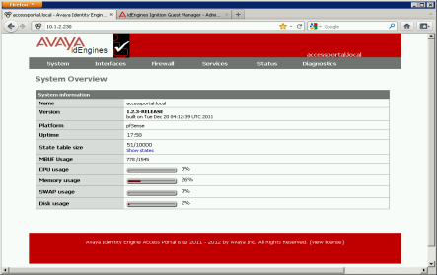
Identity Engines What’s New in 8.0? Ignition Access Portal (formerly Captive Portal)
Extends network access to guest users and devices, employee’s non-802.1x wired or wireless devices, BYOD on-boarding, and CASE Client hosting.
A single license allows deployment of multiple Access Portals for different usecases all against one Ignition Server instance (or HA-pair)
A Virtual Appliance for Vmware
ESXi 4.x and 5.0
Based on pfSense and Free BSD technology
Capable of running other services like DHCP Server or Relay, DNS forwarder etc
Requires 3 Interfaces: Admin; In; Out
Notes:
The Identity Engines Ignition Access Portal acts as a captive portal and provides the ability to authenticate and provide access to users that do not have 802.1x capability, or if it is not configured on their devices. In addition, the Access Portal provides device profiling to fingerprint user handheld devices in order to be able to apply access policies that take the device characteristics into consideration when granting network access.
The Access Portal is used for authentication of wired and wireless users and can act as a hosting place for the CASE Client.
The Access Portal also performs device profiling of wired and wireless user devices. It fingerprints user devices and auto-registers them as devices and then auto-associates it with the user profile in the Ignition Server.
The CASE Client provides client access to the secure enterprise. It is a transient client to automate configuration of managed and unmanaged guest endpoint devices to participate in Network Access Control of CASE auto-configuration of 802.1x and MS-NAP on Windows devices.

Slide 51
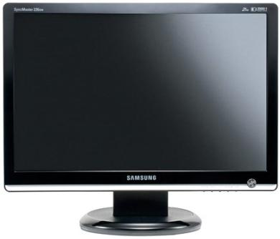
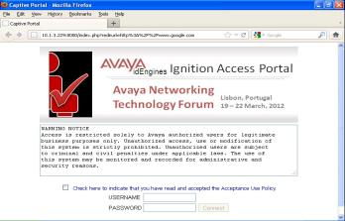
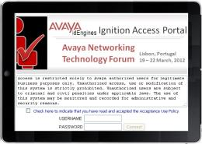
Identity Engines What’s New in 8.0? Ignition Access Portal (formerly Captive Portal)
Captive Portal (customizable) on the IN interface for wired and wireless users
User opens browser and enters corporate or guest account credentials
User authentication against the Ignition Server leveraging the Identity Routing capabilities across federated directories
Upon successful authentication, grants inline access to non-802.1x users
If enabled, performs profiling of user devices and sends device FINGERPRINT to the Ignition server
Devices Type, Devices Sub-Type, Device OS, Devices OS Version
If trusted, Ignition server automatically creates a device fingerprint records
Serves as a Captive Portal for non-802.1x clients
Unifies Wired and Wireless access
Performs device fingerprinting
BYOD On-boarding
Hosting place for the CASE Client

Slide 52
Identity Engines What’s New in 8.0? Access Portal Architecture
Access & Core Layer
Policy Decision
Identity Routing
802.1X Authentication for Employees
End-points
Wireless
RADIUS
LDAP
Access Portal
ADMIN
Ignition Server
Kerberos
HTTP Capturing
D E V I C E P R O F I L I N G
IN
Managerment and Session Provisioning
Abstracted and Identity Routing
RADIUS
OUT
Active Directory
Wired
802.1X Authentication for Employees
Guest Management
Posture Assessment
Novell/Oracle Directory
Access Portal
Corporate
Network
Reporting and Analytics
Multi-factor Authentication

Slide 53
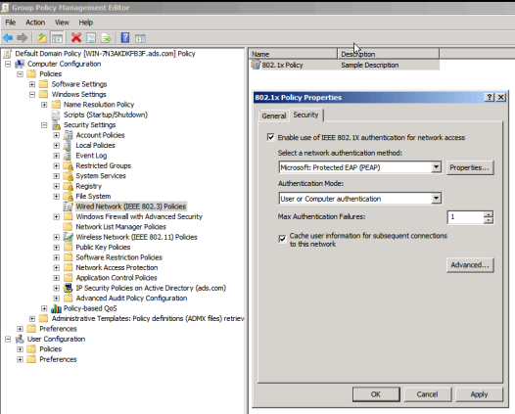
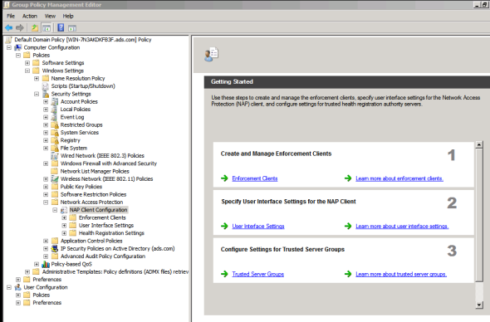
Identity Engines Leveraging Windows Group Policies
Distributing 802.1x Configuration
Distributing MAS-NAP Configuration

Slide 54
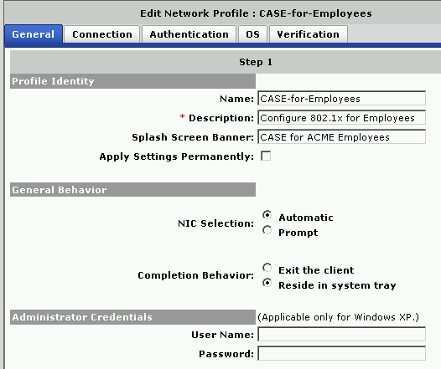
Identity Engines What’s New in 8.0? Ignition CASE Client
CASE = Client for Accessing the Secure Enterprise
A transient client to automate configuration of managed and un-managed Windows devices:
Auto-config of 802.1x
Auto-config of MS-NAP
CASE Administration Console
A Windows application
The administrator tool to customize the CASE deployment packages
CASE Profile
Set of network and security settings that allows a user to connect to a particular defined network
This profile is saved as an XML file and bundled into a CASE package, which in turn applies the settings to the user’s computer system.
CASE Deployment Package
The CASE components, packaged as a web application that you can install on your web server or the Access Portal

Slide 55
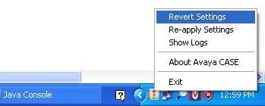
Ignition CASE Client
CASE Client
Dissolvable client that automates configuration of managed and unmanaged user Windows devices:
Auto-config of 802.1x
Auto-config of MS-NAP
Multiple packages
Wired and/or Wireless
Revertible or permanent configuration

Slide 56
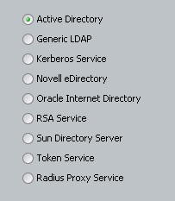
Identity Engines What’s New in 8.0? Additional Enhancements
Ignition Server as a RADIUS Proxy
Ignition Server as a Forwarder (i.e. proxy server)
Responsible for forwarding authentication
requests to another Radius server
RADIUS Proxy added as a directory services
Bulk load of Authenticators
Import of CSV files containing Authenticators data
Guest Manager
Facility for configuration export and import
Enhancements around type handling of RADIUS Framed-IP-Address attribute for “Avaya IP Office Total Care” support infrastructure deployment
Ignition Server support for VMware 5.0
Added Avaya as a vendor on the Vendors/VSAs group

Slide 57
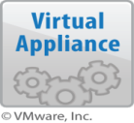
VPN Gateway Portfolio VPN Gateway for VMware
VPN Gateway for VMware
VPN Gateway 3090 for VMware
10 - 5000 concurrent IPsec/SSL Portal Sessions. 3000 w/ NetDirect
VPN Gateway 3070 for VMware
10 - 1000 concurrent IPsec/SSL Sessions
VPN Gateway 3050 for VMware
10 - 250 concurrent IPsec/SSL Sessions
AVG R9.0 – released August , 2012

Slide 58
AVG 9.0 Content
The AVG 9.0 release merged some capabilities already delivered in previous 8.x service packs along with several new UC/CC focused features.
Backward compatible with AVG 3050 and 3070
Increased VM scaling 5000 users
SPO 9.0 for UC/CC solutions
L2TP/IPSec support for Android 2.6, 3.x, 4.x, iOS 4.0/5.0
Net Direct Mac OS X 10.7 and 10.8
Two-factor authentication for AVC (server side GRIP)
Support of IP Office SSL for management (IPOffice 8.1)
AES 256 support for IPsec
OVF Support
RADIUS Group binding and authorization
Syslog reporting group
Ability to disable DNS messages from VPNG to DNS server
Disable new login for Ipsec
JavaRDP Upgrade

Slide 59
Hardware Specifications
 | 3050 VM | 3070 VM | 3090 VM
Number of CPUs | 2 | 4 | 8
Minimum CPU Speed | 2.0 GHz | 2.0 GHz | 2.0 GHz
Memory Size | 1 GB | 2 GB | 4 GB
HDD Controller Type | LSI Logic Parallel | LSI Logic Parallel | LSI Logic Parallel
HDD Type | SCSI | SCSI | SCSI
HDD Size | 20 GB | 40 GB | 40 GB
Number of HDD | 1 | 1 | 1
Ethernet card type/Vendor | Intel E1000 | Intel E1000 | Intel E1000
Number of Ethernet port | 4 | 4 | 4
Ethernet speed | 1 gig | 1 gig | 1 gig

Slide 60
Summary of VPN Gateways
System Specifications | 3050 VM | 3070 VM | 3090 VM
Maximum Concurrent VPN Sessions | 10-250 Blended support for SSL and IPSec VPN Users | 10-1000 Blended support for SSL and IPSec VPN Users | 10-5000 SSL (3000 w/ NetDirect)
Deployment positioning | Entry-level virtual appliance solution for VMWare systems | Expanded appliance solution for VMWare systems | Large concurrent user base
CPU | 2 - x86 2.0 GHz P4—equivalent processor | 4 - x86 2.0 GHz P4—equivalent processor | 8 -Minimum 2GHz processor
Memory | LSI Logic Parallel | LSI Logic Parallel | LSI Logic Parallel
On-board interfaces | SCSI | SCSI | SCSI
Drives | 20 GB | 20 GB | 40 GB

Slide 61
Simplified AACC Remote Agent Solutions SPO for Remote Agents: Deployed fast, secure, at low cost
Contact Center customers are asking for secure, virtualized environments for rapid deployment of remote agents, with more security, and at lower cost.
Solution – Avaya VPN Gateway and Secure Portable Office (SPO) for AACC Remote Agents
Preconfigured SPO can be shipped over night or downloaded from AVG.
Avaya Basic– contains basic software with Avaya 2050 IP Softphone and JRE 7
Avaya Contact Center (ACC)– contains all the applications / software of Avaya Basic , plus
Avaya Contact Center Express Desktop 5.0 and Avaya One-X Client.
SPO virtual desktop uses separate memory space, supports cache clearing.
Can be bundled AACC applications – is customizable.
Bundled VPN Client. Secure virtual environment automatically launched when USB is inserted.
AVG_9.0_SPO_CC_FCS-RC1
SPO
Net Direct
CC Remote Agent Desktop
One-X Remote Agent
AVG_9.0_SPO_BASIC_FCS-RC1
SPO
Net Direct
I2050
SPO One- X Comm AVG_9.1_<filename tbd>
SPO
Net Direct
One-X Communicator
Design Options
SPO
Avaya VPN
Gateway
(HA Cluster)
IP Office CPE
HQ
Tele-worker
Remote CC agents
SOHO router
SSL tunnel
61
Notes:
Customer buying behavior shows 25% of CC agents will be deployed as Remote Agents. Sales teams estimate 40% of the remote agent deployments are looking for virtualized desktops environments for: OneX Communicator, CCExpress, and CCRemote Agent.
SPO virtually separates users PC from corporate network thereby reducing risk to corporate network.

Slide 62
Unified Branch

Slide 63
Details Avaya Secure Router 4134 Mid-range / Small Campus
3 x Medium Module Slots, or 1 x Large Slot (using 2 Medium)
Software and Services
IPv4, IPv6 and Multicast Routing
Frame Relay (MLFR), PPP (MLPPP), HDLC
MPLS L2-VPN (Ethernet, PPP, HDLC)
L2/3 Ethernet Switching (incl. PoE)
Security Services
Firewall, IPsec VPNs, NAT
Hardware Encryption Module
SIP Gateway and Survivability
Reliability
Port Resiliency (MLPPP, MLFR, 802.1ad)
Platform Resiliency
VRRP, BGP multi-homing
Platform Redundancy
All slots are hot swappable
MPLS Fast Reroute
Survivable SIP Gateway
4 x Small Slots
WAN
LAN
PSTN
8xT1/E1
44x10/100/1000
2xFXS
4xFXS
1xDS3
1xCh DS3
10x10/100/1000
2xFXO
4xFXO
1xT1/E1/PRI
2xT1/E1/PRI
1xSerial
2xSerial
24x10/100
1xT1/E1/PRI
2xT1/E1/PRI
ADSL2+
BRI
24x10/100 POE
BRI
4134 Services Module

Slide 64
Silver Peak and Avaya Joint Benefits
Silver Peak and Avaya integrated WAN Optimization on Branch Routers
Optimizes Voice, Video and Data to Remote Offices
Eliminates dedicated networks for Unified Communications
Lowers IT costs while maintaining high quality real-time collaboration
Silver Peak is a member of Avaya’s DevConnect program
Resold through common resellers globally and are engaged in joint sales
initiatives around the world
http://www.silver-peak.com/Partners/Avaya.htm

Slide 65
Avaya SR 4134 Server Module
Avaya 4134 Secure Router
Modular multi-service Platform
Avaya SR 4134 Server Module
High performance embedded server module
2.16Ghz Core 2 Duo 64-bit 4Gb ECC 160 Gb HDD
VMware ESXi
Silver Peak VX-series Virtual Appliances
Award-winning, scalable WAN optimization in a software/virtual package
Supports Data and UC optimization (VoIP & Video)
VX-1000, VX-2000, VX-3000 support (up to 20Mb)
Third-party logos, images, and registered trademarks belong to the respective owners. Avaya is not an owner or licensee of the same.

Slide 66
Avaya SR 2330 and AG 2330 Access and Branch
Software and Services
IPv4, IPv6 and Multicast Routing
Frame Relay (MLFR), PPP (MLPPP), HDLC
MPLS L2-VPN (Ethernet, PPP, HDLC)
Security Services
Firewall, IPsec VPNs, NAT
Hardware Encryption Module
SIP Gateway and Survivability
Reliability
Port Resiliency (MLPPP, MLFR, 802.1ad)
Platform Resiliency
VRRP, BGP multi-homing
Platform Redundancy
All slots are hot swappable
MPLS Fast Reroute
Survivable SIP Gateway
WAN
PSTN
2xFXS
4xFXS
2xFXO
4xFXO
1xT1/E1/PRI
2xT1/E1/PRI
1xSerial
2xSerial
1xT1/E1/PRI
2xT1/E1/PRI
ADSL2+
BRI
BRI
Third-party logos, images, and registered trademarks belong to the respective owners. Avaya is not an owner or licensee of the same.
Notes:
The SR 2330 and AG 2330 offer a set of integrated voice interfaces that allow connection to the Public Switched Telephone Network, or PSTN, as well as support of conventional TDM-based telephony devices.
T1/E1 PRI, as well as FXS and FXO interfaces are available for flexible telephony connection with support for up to 100 simultaneous SIP users or devices.
The SR 2330 and AG 2330 Media Gateway and survivability services are interoperable with Avaya Aura® Session Manager and Communication Server 1000. They are also compatible with Microsoft OCS 2007 as well as other third-party SIP call servers for flexible branch gateway deployment.
It seems the SR 4134, SR 2330 and AG 2330 have a lot in common. Could we do a quick summary to see when we should position which one?

Slide 67
Campus and Data Center Design

Slide 68
Campus Network Architecture Classic Switch Clustering
High performance stackables at the edge supporting Plug and Play Provisioning
Campus Core
Distribution
(Optional)
Edge
Data Center
Switch Clustering between tiers – scalable from small to large enterprise providing active/active at Layer 2 or Layer 3
Active Standby
Active Active
Which aircraft would you rather be flying?

Slide 69
Data Center Infrastructure Horizontal Stacking / ToR / Switch Clustering
Switch Cluster Core
Logical View
IST
IST
Distribution / Core
SMLT
IST
IST
Horizontal Stack Switch Cluster
SMLT
NIC Team
Server
iSCSI Initiators
iSCSI Array
Horizontal Stack
SAN
Notes:
First we will look at a typical server access solution. We have a number of servers, each providing a series of virtual server environments. These switches are organized in two horizontal stacks, which are interconnected through an IST, so they form a switch cluster. Each of the physical servers is dual homed through an SMLT into two Top of Rack (ToR) switches, offering sub second fail-over supporting redundancy.
The servers are also connected to a horizontal stack that provides connectivity to the Storage Area Network, with for instance an iSCSI array.
Here is the logical view of this solution.
For this type of solution we are partnering with companies like VMware, to integrate Virtual Server management in our virtual network management tools, with Coraid for converged Ethernet storage and with Dell Equallogic for iSCSI storage.

Slide 70
Mid-Tier Data Center Solution Collapsed Core
Collapsed Core Campus/Data Center
ERS 8800
Switch Cluster
ERS 8800
Standalone
ERS 8800
ERS 5600 Stack
ERS 5600 Switch Cluster
High Density Gigabit with 10 Gigabit
Highly Scalable Performance/Features
Full Layer 3 with Virtualization
ERS 5600
ERS 4000
10/100/1000/10G & Redundant Power
Advanced Stacking Technology
Unlimited Lifetime Warranty
10/100 & 10/100/1000
Advanced Stacking Technology
Unlimited Lifetime Warranty
Top of Rack
Horizontal Stack
ERS 4500
ERS 5600
Top of Rack Switch
ERS 4000
ERS 5600
VSP7000
Top of Rack
Horizontal Stack Switch Cluster
ERS 5600
VSP7000
Notes:
For the mid-sized solution we can build a core solution based on a ERS 4000 or ERS 5000 series stack of LAN switches. To add a level of resiliency we can create a switch cluster, which allows us to create SMLT connections to the Top of Rack switches, to have sub second fail-over resiliency.
If we start off with higher port densities we can consider a collapsed core using a chassis based solution such as an ERS 8800. Of course in this type of solution we can also create a higher resiliency solution by creating a switch cluster and add another level of resiliency by creating a switch cluster in the Top of Rack as well.

Slide 71
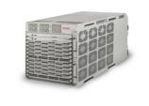
Large Data Center Solution Data Center Core
VSP 9000
Data Center Switch Cluster Core
ERS 8800
ERS 5600
VSP 9000
High Density 10Gig and Gigabit
Lossless Ethernet Capable
N+1 Switch Fabric Redundancy
Virtualization Provisioning Service
Network / Server Visibility
Configuration / Automation
VMware Support
VSP 7000
Top of Rack Switch
ERS 400
ERS 5600
VSP 7000
Top of Rack
Horizontal Stack
ERS 5600
VSP 7000
24 port SFP+ with MDA
Multi-Terabit Fabric Interconnect
Unlimited Life time Warranty
Top of Rack
Horizontal Stack Switch Cluster
ERS 5600
VSP 7000
Notes:
In large Data Center solutions we can also implement VSP 9000 in the core. In the server access we have another option: the VSP 7000, supporting Gigabit and 10 Gigabit through SFP+. It includes an MDA, a Media Dependent Adaptor. This MDA allows us to add specific interfaces to address specific customer requirements.
The VSP 7000 can operate as a stand-alone ToR switch, and with release 10.2 the fabric connect stack capability is enabled. SMLT support is also planned.
The Virtualization Provisioning Service or VPS is the tool we use to configure the VSP based solution, to create a set-up that allows for automatic moves, add and changes to VMware based virtual servers. The Virtualization Provisioning Service is a plug-in to COM, Communication and Orchestration Manager.

Slide 72
Separating Network Services from Infrastructure
The major problem that complicates network operations significantly is the limited abstraction of a “network connectivity service” from the infrastructure.
The connectivity services and infrastructure configurations are tightly coupled and cannot easily be separated from each other.
VLAN definition must be applied on each specific switch moving the traffic.

Slide 73
Avaya VENA Fabric Connect
Virtual network created in seconds
Time to service greatly improved
Dynamic on-demand infrastructure
DC2
DC1
One touch provisioning at the fabric edge
Eliminates network re-designs and scheduled outages
Network Core Layer
Virtual Service Network
Compute Access Layer
Compute Infrastructure

Slide 74
SPBM SMLT NNI Considerations
SPB (and its underlying protocol IS-IS) currently only supports pt-to-pt adjacencies
Only one link or one MLT is supported between a pair of ERS 8800 or VSP9000 switches
Single port Ethernet
MLT (1 to 8 ports) considered as a pt-to-pt link

Slide 75
New Capabilities Create New Challenges
Lack of network visibility into the virtual machine lifecycle
While VMs move dynamically from Server to Server, provisioning the network has proven to be an administrator’s challenge
No visibility of end-to end deployment & unable to validate change upon specific business needs
No real-time view of VM & application location & delivery needs
Troubleshooting nightmare & finger-pointing
Blurred operational boundary between System Admin & Network Operators

Slide 76
Avaya VPS Licensing
SKU / License | Nodes Supported | Pre-Req
AH2735010 / VPS_Base | 20 | COM_Ent2.3_50_base
AH2735011/ VPS_INCR | 50 | VPS_Base
An Ethernet switch is considered a node
Each unit in a stack is considered a separate node
Avaya VPS Licenses available at the Avaya Licensing Portal
Trial VPS Licenses needs to be acquired from APS / PLM
Avaya VPS Trial licenses are valid for 60 days
A total of 4 increments can be applied to an Avaya VPS base
supporting a total of 220 network nodes

Slide 77
Virtual Provisioning Service Solution Architecture
Integrates via a bi-directional data exchange (based on VMware secured API) between Avaya COM and VMware vCenter
Delivers a relay for end-to-end management of Servers and network in the virtualized datacenter environment
Provides visibility, validation, provisioning automation, & reporting of the network hardware and the vswitch
Provisioning of connectivity profiles, i-SID and VLAN IDs in the appropriate VM management applications
Inventory & Sync of VM-related asset data
Auditability and VM tracking
Validation of VM QoS, QoE
VM Location (Switch, Port, Time etc)
Allocated connectivity profile (VM to Network/profile)
VPS
Rules
COM
Templates
Open API
VMware
vCenter
Notes:
Requires no changes to the VMware environment
VPS licensing is done 'per-Ethernet switch', keeping costs low.
VPS requires a base license supporting up to 20 nodes, and upgrade licenses can be purchased to support up to 220 nodes.

Slide 78
VPS Plug-in to COM
Launch the VPS Dashboard
Launch the Element Manager to configure individual devices

Slide 79
Avaya VPS Dashboard Monitor
Notes:
Dashboard pane, framed in red, shows the Monitor. Each line in the Monitor pane relates to an event that has occurred in one of the Data Centers.
Examples include: VMcreate, VMmigrate, VMdelete or reconfiguration notifications. Each monitor event shows details about how this event was handled.
If an event triggered a Rule, or if a new Network Profile has been applied, it is shown in this pane. In addition, when configuration changes are pushed down to the devices, this will show as an event.

Slide 80
VENA Unified Access Unifying Wired and Wireless at the Network Core
Delivers Avaya’s first integrated wired/wireless solution
Integrates WLAN 8100 2.0 & ERS 8800 7.2
Wireless data forwarding capability embedded in the ERS 8800 core switches
WLAN 8180 for management/control traffic only
Unprecedented Scaling
Leverage core switching network to accommodate huge growth in mobile traffic
Focus is on the scaling of data traffic, not just # of APs per Controller anymore.
Best suited for Medium – Large Enterprise Campus and Data center deployments
Unified Access 1.0
WLAN 8100 2.0
ERS 8800/8600 7.2

Slide 81
Unified Access 1.0 Solution and Release Content
Software only upgrade
WLAN 8180 dedicated as the wireless control plane (wireless management traffic only)
512 AP support
Multicast Video enhancements
RF Packet Capture
Client Load-balancing
WLAN 8100 2.0
Software only upgrade
No additional License requirement
WLAN forwarding integration
( in addition includes other features such as MCAST over SPB)
ERS 8800/8600 7.2

Slide 82
Unified Access 1.0 Program Overview At a Glance
WLANv2.0 and ERS 8800 v7.2 deliverable include the following components:
Overlay model - Continue support for 8180 Overlay solution with both Control & Data Plane on 8180 - (8180 WCP + 8180 WSP)
Integrated Solution - 8180 WCP + 8800 WSP (8800 with v7.2 or later only)
No support for mixed mode i.e. 1 & 2 above on the same Mobility domain not supported.
WMS and EDM support for entire system in all cases above.
In addition, WMS improvements as required via field feedback.
Additional debug improvements including Remote Packet Capture on APs
Multicast over SPB deliverables summary including EDM support:
L2 VSN with IGMP support on the access networks for optimized forwarding of IP Multicast traffic in a bridged VSN
IP Multicast routing support for Global Routing table based on SPB BEBs and IGMP on the access
L3 VSN with VRF based IP Multicast routing support on SPB BEBs and IGMP on the access
Key Considerations:
SPBm and WLAN Unified Access cannot be enabled on the same 8800 device.
Unified Access can be enabled on SMLT configs with resiliency limited to standard WSP failover.
SMLT support for WLAN limited to Link failure only. (Nodal failure support in subsequent release)
Complete support for all APs- 8120, 8120-E AND 8120-O
ERS 8800 HW Baseline from Release 7.1.x

Slide 83
Avaya VENA Unified Access Architecture System Protocols
AP Control Protocol
Protocol used by WCP to manage and control the access point
Controller Clustering Protocol
Protocol running between WC’s in a domain
Single point of management, control and monitoring
Mobility Control Protocol
Avaya designed protocol used to control a mobility switch
Tunnel Protocol (TuP)
Avaya designed protocol used to establish and maintain data plane tunnels
Both access tunnels and mobility tunnels use the same protocol
Mobility VLAN Management Protocol (MVMP)
Avaya designed peer-2-peer protocol between mobility agents and access points
VLAN Membership Management (VMM) is used to manage tunnel memberships on mobility VLAN's.
VLAN Server Election (VSE) is used between switches on mobility tunnels
Notes:
The access point control protocol is used by the wireless LAN Control Processor to manage and control the access point.
The controller clustering protocol is used between wireless LAN controllers in a domain delivering a single point of management, control and monitoring.
The mobility control protocol is an Avaya designed protocol used to control a mobility switch.
The tunnel protocol, another Avaya designed protocol, is used to establish and maintain data plane tunnels. These are the tunnels used to transport the data from a user or a device to the destination switch for the corresponding user or device VLAN connectivity.
Both access tunnels and mobility tunnels use the same protocol.
The mobility VLAN management protocol, also Avaya designed, is a peer-2-peer protocol used between mobility agents and access points.
VLAN membership management is a function that is used to manage tunnel memberships on mobility VLAN's. VLAN server election is used between switches on mobility tunnels.

Slide 84
Knowledge Checkpoints

Slide 85
Knowledge Checkpoint 1
Background
Prime Auditors, Inc is a small Enterprise accounting firm with 175 employees located in a one-story building in downtown. Prime’s employees are using their PCs actively, preparing and reviewing their customer’s tax forms, and making frequent telephone calls for clarification or to provide status updates.
The VP of Operations at Prime Auditors just committed to purchasing a new Avaya IP Office system to help modernize the business, with 100% IP Phones. The partner account team has convinced the VP to consider an all-Avaya network on which to run the new voice system. The VP wants Gigabit speeds for the PC, and wants to minimize the re-cabling costs – so he wants to use a single Ethernet drop per employee.

Slide 86
Knowledge Checkpoint 1
Current Infrastructure
A single closet comprised of eight Enterasys 24-port 10/100 switches, inter-connected via front-panel 100Mb copper links. The switches are old, and need to be replaced.
Requirements
175 Ethernet ports for phones/PCs, all located in the computer room the first floor
10 Ethernet ports to support the e-mail server, firewall and Accounting
applications servers
Connect desktop PCs via the LAN port of the IP Phones, at 1 gigabit speed
The VP does not want any bottlenecks between switches

Slide 87
Knowledge Checkpoint 1
Task
Choose the best answer, and consider you can still find areas to upsell during later discussions.
Propose a stack comprised of 8 ERS 3524GT-PWR+ switches, providing the 1GB connection with PoE+ for IP Phones/PCs. This solution provides a total of 192 PoE+ ports, easily supporting the 175 phones with attached PCs and 10 servers. Avaya’s Flexible Advanced Stacking Technology (FAST) eliminates bottlenecks between switches, providing great performance between the PCs and servers, and is managed as one device via its web interface.
Propose two stacks, each comprised of 4 ERS3524GT-PWR+ switches , providing the specified 1Gb connection with PoE+ for IP Phones/PCs. Interconnect the stacks using two 1Gb copper ports defined as distributed MLT for resiliency. This solution provides a total of 192 PoE+ ports, easily supporting the 175 phones with attached PCs and 10 servers. Avaya’s Flexible Advanced Stacking Technology (FAST) eliminates bottlenecks between switches, providing great performance between the PCs and servers, and is managed as one device via its web interface.
Propose a stack conprised of 4 ERS2550T-PWR switches to support the 1Gb PoE ports for IP Phones/PCs, and the 10 servers. This solution provides 192 ports for phones and daisy-chaned PCs. . Avaya’s Flexible Advanced Stacking Technology (FAST) eliminates bottlenecks between switches, providing great performance between the PCs and servers.
Propose a stack comprised of 8 ERS 3526-PWR+ switches, providing the 1GB connection with PoE+ for IP Phones/PCs. This solution provides a total of 192 PoE+ ports, easily supporting the 175 phones with attached PCs and 10 servers. Avaya’s Flexible Advanced Stacking Technology (FAST) eliminates bottlenecks between switches, providing great performance between the PCs and servers, and is managed as one device via its web interface.

Slide 88
Knowledge Checkpoint 1
Task
Choose the best answer, and consider you can still find areas to upsell during later discussions.
Propose a stack comprised of 8 ERS 3524GT-PWR+ switches, providing the 1GB connection with PoE+ for IP Phones/PCs. This solution provides a total of 192 PoE+ ports, easily supporting the 175 phones with attached PCs and 10 servers. Avaya’s Flexible Advanced Stacking Technology (FAST) eliminates bottlenecks between switches, providing great performance between the PCs and servers, and is managed as one device via its web interface.
Propose two stacks, each comprised of 4 ERS3524GT-PWR+ switches , providing the specified 1Gb connection with PoE+ for IP Phones/PCs. Interconnect the stacks using two 1Gb copper ports defined as distributed MLT for resiliency. This solution provides a total of 192 PoE+ ports, easily supporting the 175 phones with attached PCs and 10 servers. Avaya’s Flexible Advanced Stacking Technology (FAST) eliminates bottlenecks between switches, providing great performance between the PCs and servers, and is managed as one device via its web interface.
Propose a stack conprised of 4 ERS2550T-PWR switches to support the 1Gb PoE ports for IP Phones/PCs, and the 10 servers. This solution provides 192 ports for phones and daisy-chaned PCs. . Avaya’s Flexible Advanced Stacking Technology (FAST) eliminates bottlenecks between switches, providing great performance between the PCs and servers.
Propose a stack comprised of 8 ERS 3526-PWR+ switches, providing the 1GB connection with PoE+ for IP Phones/PCs. This solution provides a total of 192 PoE+ ports, easily supporting the 175 phones with attached PCs and 10 servers. Avaya’s Flexible Advanced Stacking Technology (FAST) eliminates bottlenecks between switches, providing great performance between the PCs and servers, and is managed as one device via its web interface.

Slide 89
Knowledge Checkpoint 2
Background
A large municipality has tasked IT to provide a refreshed networking infrastructure providing increased bandwidth to all locations over its already existing fiber plant. Currently they use MPLS to insure well-isolated inter-agency communication, security services (e911, cameras, building access, etc) and ‘smart’ building controls.
In addition, the city wants to offer shared/private cloud services to each agency. The want to implement this across two redundant Data Centers in a VMware environment using vCenter.

Slide 90
Knowledge Checkpoint 2
Current Infrastructure
The core is realized on Cisco Catalyst 6500. The server farm is currently networked using Cisco’s stackable Catalyst 3750 Series. The MPLS WAN is implemented using Cisco’s Catalyst 6500
Requirements
Redundant 10Gb Ethernet handoff to 15 locations, and redundant 1 Gb Ethernet
handoff to 30 locations spanning both Data Centers
Within each Data Center, a number of Gig attached virtual servers exist with
the need to migrate to 10Gb server connections
The core will need to support 10Gb today with a roadmap to 40/100Gb
Proactive Network Management and ease of use is extremely important.

Slide 91
Knowledge Checkpoint 2
Task
Which products do you think would be the best fit for the Data Center core, the Data Center server farm, and the connectivity in remote locations?
VSP 9000, ERS 5600, ERS 8800
VSP 9000, VSP7000, ERS 8800
VSP 9000, VSP 7000, ERS 5600
ERS 8800, VSP 7000, ERS 5600

Slide 92
Knowledge Checkpoint 2
Task
Which products do you think would be the best fit for the Data Center core, the Data Center server farm, and the connectivity in remote locations?
VSP 9000, ERS 5600, ERS 8800
VSP 9000, VSP7000, ERS 8800
VSP 9000, VSP 7000, ERS 5600
ERS 8800, VSP 7000, ERS 5600

Slide 93
Knowledge Checkpoint 3
Background
A large School District would like to deploy Wireless LAN across the district for 30 Elementary Schools, 30 Middle Schools, and 30 High Schools.

Slide 94
Knowledge Checkpoint 3
Current Infrastructure
The current wireless infrastructure offers a partial coverage using older Aruba equipment. Gigabit WAN connectivity is currently in place between all school locations over an MPLS Layer 2 circuit. The local carrier provides redundancy between two geographically dispersed Data Centers.
Requirements
Each school will have approximately 50 APs serving up to 500 wireless clients
Mobility between schools of the same type (Elementary, Middle and High) should
be seamless
Wireless access will be given to Admin staff, Students, and Guest usage for parents
For Admin staff, all connected MS-Windows based devices must have a firewall
running, along with updated Anti-Virus software.
Each school type will separately maintain control for wireless access (including
guest usage), and provide individualized splash screens for guest users
All internet connectivity should be sourced from the two Data Centers, where
centralized security is applied. However, wireless client-to-wireless client, as
well as wireless client to wired activity within a school should remain within
that school.

Slide 95
Knowledge Checkpoint 3
Task 1
How many mobility domains do you think should be configured?
1 (Single mobility domain for the District)
3 (1 for each school type)
90 ( 1 for each school)

Slide 96
Knowledge Checkpoint 3
Task 1
How many mobility domains do you think should be configured?
1 (Single mobility domain for the District)
3 (1 for each school type)
90 ( 1 for each school)

Slide 97
Knowledge Checkpoint 3
Task 2
Having decided to configure three mobility domains, how many WLAN Controllers are needed?
96 WLAN Controllers
(1 Controller at each school (Elementary, Middle and High), plus 3 per Data Center
92 WLAN Controllers
(1 Controller at each school (Elementary, Middle and High), plus 1 per Data Center
36 WLAN Controllers
(18 Controller at each Data Center, where 6 Controllers are used for each school type (Elementary, Middle and High)
6 WLAN Controllers
(3 Controller at each Data Center, where 1 Controller is used for each school type (Elementary, Middle and High)

Slide 98
Knowledge Checkpoint 3
Task 2
Having decided to configure three mobility domains, how many WLAN Controllers are needed?
96 WLAN Controllers
(1 Controller at each school (Elementary, Middle and High), plus 3 per Data Center
Each school requires a WLAN controller to keep its intra-site traffic local. The Data Center WLAN controllers, although not attaching APs, allow for mobility tunnels to be established (tunneled over IP) to individual school controllers for Guest internet traffic sourced from the Data Center. Since a controller can only be part of a single mobility domain, 3x are needed at each Data Center (1x peer school type).

Slide 99
#AvayaATF
@gbruenin56

