Slide 2
Deploying Services over Avaya Fabric Connect
Jeff Cox
Senior Solutions Architect
Avaya
@jeffcox65

Slide 3
Agenda
SPBM Overview
CFM (Connectivity Fault Management) 802.1ag
SPBM – SMLT
SPBM Services
SPBM Configuration

Slide 4
SPB Overview
Shortest Path Bridging is defined in the IEEE 802.1aq standard
802.1aq Summary
  Build much larger networks than today’s STP networks
  Multiple equal cost paths
  Fast convergence
  Support for large mesh networks
  Scalability – addresses Mac address explosion
  Loop prevention & suppression
  Use all links. Does not block and waste link resources
  Use shortest path for unicast and multicast traffic
  Service virtualization (L2, L3 VPNs)
  Simple encapsulation
  CFM – Connectivity Fault Management – Layer 2 ping, traceroute, tracetree

Slide 5
SPB Overview
Continued
802.1aq supports two modes, SPB VID (SPBV) and SPB MAC (SPBM) where the ERS 8600/8800 supports SPBM
  SPBV uses Q-in-Q IEEE 802.1ad encapsulation
  SPBM uses MAC-in-MAC IEEE 802.1ah
Control protocol for 802.1aq is IS-IS* with a small number of TLVs
  IS-IS is only used on NNI links between SPB switches
  IS-IS is used to discover and advertise the network topology and compute shortest path trees from all bridges in the SPB Region
In SPBM, service instances are delineated by Logical Group Identifiers (I-SID)
* Intermediate System to Intermediate System

Slide 6
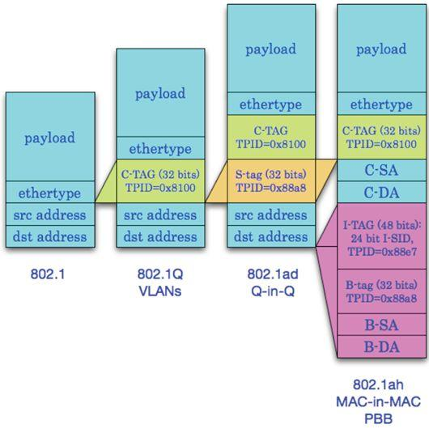
Shortest Path Bridging MAC (SPBM)
Ethernet Encapsulation (MAC-in-MAC)
C-SA = Customer Source MAC
C-DA = Customer Destination MAC
C-TAG = Customer TAG
TPID = Tag Protocol IDentifier
S-TAG = Service TAG
I-TAG = Service Instance TAG
I-SID = Service ID
B-TAG = Backbone TAG
B-DA = Backbone DA
B-SA = Backbone SA

Slide 7
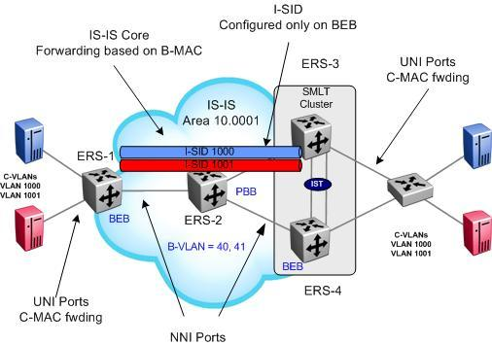
SPBM Terminology
BEB: Backbone Edge Bridge
BCB: Backbone Core Bridge
C-VLAN: Customer VLAN
B-VLAN: Backbone VLAN
B-MAC: Backbone MAC
C-MAC: Customer MAC
I-SID: Backbone Service Instance, IEEE 802.1ah
SPB: Shortest Path Bridging
SPBM: Shortest Path Bridging MAC
CFM: Connectivity Fault Management
IS-IS: Intermediate System to Intermediate System
TLV: Type Length Value

Slide 8
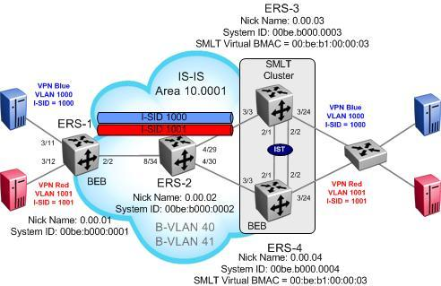
SPBM
Reference Details
SPBM needs to be enabled on all core switches
  Nick-name (x.xx.xx)
  B-VLANs
  IP (only for L3)
IS-IS needs to be enabled on all core switches
  IS-IS area
  System ID (recommended)
IS-IS Interface
  Only pt-to-pt
  Enabled on port or MLT
I-SIDs are on C-VLANs and/or VRFs to identify L2 or L3 services

Slide 9




SPBM – L2VSN
What does it solve?
Inception:
Target:
8600G
8600A
3/5
3/11
3/2
8600C
3/1
MLT1
MLT1
3/12
3/3
4/30
3/21
3/22
3/29
3/30
IST
IST
4/1
4/20
4/30
3/29
3/30
Tester
4/29
Tester
4/11
3/3
SMLT
4/29
I-SID 10
3/1
Core has to do MAC learning and flooding
No end-point provisioning
4/12
MLT30
3/2
VLAN must be provisioned on all switches, e.g. for VLAN 10, configuration of VLAN 10 is required on all switches
8600D
VLAN 10
8600B
8600G
8600A
Backbone VLANs in core running IS-IS (SPBM)– simple one time configuration
3/5
3/11
3/2
8600C
3/1
MLT1
IS-IS (SPBM)
3/12
3/3
4/30
3/21
3/22
3/29
3/30
MLT 1
IST
4/1
4/20
4/30
3/29
3/30
Tester
4/29
Tester
VLAN 10
4/11
3/3
SMLT
VLAN 10
4/29
3/1
C-VLAN & I-SID mapping configured only on edge. Customer MAC learning and flooding only done on edge
4/12
3/2
C-VLAN & I-SID mapping configured only on edge. Customer MAC learning and flooding only done on edge
Core does not learn Customer VLAN/MAC
8600D
8600B

Slide 10

SPBM – GRT Shortcuts
What does it solve?
Inception:
Target:
8600G
8600A
IP Subnet A – Passive or active interface IGP
3/11
3/2
3/5
3/1
MLT1
8600C
MLT1
3/12
3/3
Two Core OSPF Vlans:
Vlan 921 10.0.21.0/24
Vlan 922 10.0.22.0/24
Two Core OSPF Vlans:
Vlan 911 10.0.11.0/24
Vlan 912 10.0.12.0/24
4/30
3/21
3/22
3/29
3/30
RSMLT
IST
RSMLT
IST
10.0.2.0/24
VLAN 1002
10.0.1.0/24
RSMLT
4/1
4/20
4/30
3/29
3/30
Tester
4/29
Tester
VLAN 1001
4/11
3/3
SMLT
4/29
3/1
RSMLT + OSPF in Core
4/12
3/2
MLT30
IP Subnet B – IGP Protocol
8600D
8600B
IP Subnet C – IGP Protocol
IP Subnet D – IGP Protocol
8600G
8600A
3/5
3/11
3/2
8600C
3/1
MLT1
IP Subnet A – No IGP required
3/12
3/3
4/30
3/21
3/22
3/29
3/30
10.0.1.0/24
IS-IS
MLT 1
IST
10.0.2.0/24
VLAN 1002
4/1
4/20
4/30
3/29
3/30
Tester
4/29
Tester
VLAN 1001
4/11
3/3
SMLT
IP Shortcuts over IS-IS
4/29
3/1
4/12
3/2
Backbone VLANs in core running IS-IS simple one time configuration
IP Subnet B– No IGP required
8600D
8600B

Slide 11

SPBM – L3VSN
What does it solve?
8600G
8600A
VRF Configuration, IGP configuration, iBGP peering, MPBGP, Route Targets, Router Distinguishers
Inception:
Target:
3/5
3/11
3/2
8600C
3/1
MLT1
MLT1
3/12
3/3
Two Core OSPF Vlans:
Vlan 921 10.0.21.0/24
Vlan 922 10.0.22.0/24
Two Core OSPF Vlans:
Vlan 911 10.0.11.0/24
Vlan 912 10.0.12.0/24
4/30
3/21
3/22
3/29
3/30
RSMLT
IST
RSMLT
IST
RSMLT
4/1
4/20
4/30
3/29
3/30
VRF Configuration, IGP configuration, iBGP peering, MPBGP, Route Targets, Router Distinguishers
Tester
Tester
VLAN 1001
4/29
4/11
3/3
SMLT
4/29
3/1
4/12
3/2
10.0.2.0/24
VLAN 1002
I-SID 101
MLT30
8600D
8600B
IP Subnet B – IGP Protocol
IP Subnet C – IGP Protocol
8600A
8600G
3/5
3/11
3/2
8600C
3/1
MLT1
3/12
3/3
VLAN 101
IS-IS (SPBM)
4/30
3/21
3/22
3/29
3/30
10.0.101.0/24
MLT 1
IST
4/1
4/20
4/30
3/29
3/30
Tester
4/29
Tester
4/11
3/3
SMLT
VRF Configuration &
I-SID mapping
4/29
3/1
4/12
3/2
VLAN 102
VRF Configuration &
I-SID mapping
Backbone VLANs in core running IS-IS (SPBM)– simple one time configuration
8600D
8600B

Slide 12
SPBM
SPBM (Shortest Path Bridging – MAC, previously known as SPBB) provides additional values which capitalize on IEEE 802.1ah (PBB) capabilities.
SPBM reuses the IEEE 802.1ah (PBB) data plane which does not require that the Backbone Core Bridges (BCB) learn encapsulated client addresses (C-MAC).
  Individual MAC frames (unicast traffic) from an Ethernet attached device that are received at the SPBM edge are encapsulated in a (MAC-in-MAC) IEEE 802.1ah header and then traverse the network unchanged until they are stripped of the encapsulation as they egress back to the non participating attached network at the far side of the participating network

Slide 13
SPB
Shortest Path Bridging
The SPB service is made possible by adding a new header with an I-SID, a BVLAN with source and destination B-MAC addresses
The B-VLAN is a 802.1Q VLAN used in the core used to transport the PBB EVPNs
  the p-bits contained within the 802.1Q VLAN header provide QoS capabilities

Slide 14
Shortest Path Bridging
The backbone simply provides forwarding between backbone switches where the unicast-fib is populated by B-MAC
  Each bridge has one unique MAC address known as the B-MAC and advertised by IS-IS as the SYS-ID
  On the ERS 8600/8800, this is the system-id which can be configured or left as-is
    Good idea to change the system-id to easily identify switches in the IS-IS forwarding table
ERS-2> show isis system-id
================================================================================
ISIS System-Id
================================================================================
SYSTEM-ID
--------------------------------------------------------------------------------
00be.b000.0002
ERS-1> show isis spbm unicast-fib vlan 40
================================================================================
SPBM UNICAST FIB ENTRY INFO
================================================================================
DESTINATION BVLAN SYSID HOST-NAME OUTGOING COST
ADDRESS INTERFACE
--------------------------------------------------------------------------------
00:be:b0:00:00:02 40 00be.b000.0002 ERS-2 2/2 10
00:be:b0:00:00:03 40 00be.b000.0003 ERS-3 2/2 20
00:be:b1:00:00:03 40 00be.b000.0003 ERS-3 2/2 20
00:be:b0:00:00:04 40 00be.b000.0004 ERS-4 2/2 20

Slide 15
SPBM
I-SID L2 VSN
The I-SID is the ‘Instance Service Identifier’ made up of a 24-bit field providing over 16 million possible VSN-id’s. The I-SID is used to identify the VSN service.
  Each I-SID is assigned a unique identifier (valid range 1 to 16777215)
  For L2 VSN, I-SID assigned at VLAN level
ERS-1# show config module vlan
#
# VLAN CONFIGURATION - PHASE I
#
vlan 1000 create byport 1 name "VSN-Blue"
vlan 1000 i-sid 1000
ERS-1# show isis spbm i-sid all
================================================================================
SPBM ISID INFO
================================================================================
ISID SOURCE NAME VLAN SYSID TYPE
--------------------------------------------------------------------------------
1000 0.00.01 40 00be.b000.0001 config
1000 0.00.02 40 00be.b000.0002 discover
1000 0.00.03 40 00be.b000.0003 discover
1000 0.00.04 40 00be.b000.0004 discover

Slide 16
SPBM
I-SID L3 VSN
For L3 VSN, I-SID assigned at VRF level
ERS-1# show config module ip
#
# VRF CONFIGURATION
#
ip vrf green create id 1
#
# CIRCUITLESS IP INTERFACE CONFIGURATION - VRF
#
ip vrf green circuitless-ip-int 2 create 10.1.1.1/
255.255.255.255
#
# IPVPN CONFIGURATION
#
ip vrf green ipvpn create
ip vrf green ipvpn i-sid 1002
ip vrf green ipvpn enable
#
# IP REDISTRIBUTION CONFIGURATION - VRF
#
ip vrf green isis redistribute direct create
ip vrf green isis redistribute direct metric 1
ip vrf green isis redistribute direct enable
ERS-1# show isis spbm ip-unicast-fib all
*******************************************************************************
Command Execution Time: WED DEC 01 09:39:04 2010 EST
*******************************************************************************
================================================================================
SPBM IP-UNICAST FIB ENTRY INFO
================================================================================
OUTGOING SPBM PREFIX
VRF ISID Destination NH BEB VLAN INTERFACE COST COST
--------------------------------------------------------------------------------
green 1002 10.5.1.3/32 ERS-3 40 2/2 20 1
green 1002 10.5.1.3/32 ERS-3 41 2/2 20 1
green 1002 10.5.102.0/24 ERS-3 40 2/2 20 1
green 1002 10.5.102.0/24 ERS-3 41 2/2 20 1

Slide 17
SPBM
Unicast
Unicast Ethernet frames in SPBM are encapsulated with a destination B-MAC and a source B-MAC and a backbone VLAN ID
  The backbone source address is a B-MAC associated with the ingress 802.1aq bridge
  The backbone destination address is a B-MAC associated with the egress 802.1aq bridge
  B-VID – 802.1aq specification allows for tagged or untagged frames
    ERS 8600/8800 uses VLAN tagging
  The FDB entries map destination B-MAC, B-VID to an outgoing interface based on IS-IS database and computations

Slide 18
SPBM
IS-IS LSDB Details 1 of 2
ERS-1# show isis lsdb sysid 00be.b000.0003 detail
===================================================
ISIS LSDB (DETAIL)
===================================================
---------------------------------------------------
Level-1 LspID: 00be.b000.0003.00-00 SeqNum: 0x000004d9 Lifetime: 537
Chksum: 0xd4df PDU Length: 237
Host_name: ERS-3
Attributes: IS-Type 1
TLV:1 Area Addresses: 1
10.0001
TLV:3 End System Neighbors:
Metric: 0
00beb0000003 (ERS-3)
TLV:22 Extended IS reachability:
Adjacencies: 2
TE Neighbors: 2
00be.b000.0002.00 (ERS-2) Metric:10
SPBM Sub TLV:
Instance: 0
Attr: 0
Metric: 10
00be.b000.0004.00 (ERS-4) Metric:10
SPBM Sub TLV:
Instance: 0
Attr: 0
Metric: 10
TLV:129 Protocol Supported: SPBM
TLV:180 SPBM INSTANCE:
Instance: 0
Attr: 0
OUI: 00-00-03

Slide 19
SPBM
IS-IS LSDB Details 2 of 2
TLV:183 ISID:
Instance: 0
Metric: 0
B-MAC: 00-be-b0-00-00-03
BVID:40
Number of ISID's:2
1000(Both),1001(Both)
Instance: 0
Metric: 0
B-MAC: 00-be-b0-00-00-03
BVID:41
Number of ISID's:2
1000(Both),1001(Both)
Instance: 0
Metric: 0
B-MAC: 00-be-b1-00-00-03
BVID:40
Number of ISID's:1
16777215(None)
TLV:184 SPBM IPVPN Reachability:
Vrf ISID:1002
Metric:1 Prefix Length:32
IP Address: 10.5.1.3
Vrf ISID:1002
Metric:1 Prefix Length:24
IP Address: 10.5.102.0
IP Networks
Received
Via
I-SID 1002
B-VID
40
B-VID
41
Virtual
B-MAC

Slide 20
SPBM
IS-IS Type Length Value (TLV) Details
Some important TLV details can be viewed by issuing the following commands:
  Area address – type 1
    show isis lsdb tlv 1 detail
  End System Neighbors – type 3
    show isis lsdb tlv 3 detail
  Extended IS Reachability Information – type 22
    show isis lsdb tlv 22 detail
  Protocols Supported – type 129
    show isis lsdb tlv 129 detail
  Extended IP Reachability – type 135 (SPB Native IP Shortcuts)
    show isis lsdb tlv 135 detail
  Extended Reachability TLV – type 180
    show isis lsdb tlv 180 detail
  SPBM IP Reachability TLV – type 184
    show isis lsdb tlv 184 detail

Slide 21
SPBM
Unknown Traffic
SPBM uses source specific multicast trees
SPBM (S,G) forms the destination B-MAC by concatenating the 20 bit SPB unique nickname and the 24-bit I-SID
Broadcast, multicast and unknown unicast frames arriving on a UNI port are:
  Encapsulated using this destination B-MAC address for the I-SID defined
    The destination B-MAC uniquely identifies the encapsulating node or root of the multicast distribution tree

Slide 22
SPBM
Unknown Traffic
Example : ERS-1 Nickname = 0.00.01 , I-SID = 1000 (0x3e8)
  Multicast Address = 03:00:01:00:03:e8
NICK-NAME & “3”
I-SID in Hexadecimal
ERS-1# show isis spbm multicast-fib i-sid 1000
================================================================================
SPBM MULTICAST FIB ENTRY INFO
================================================================================
MCAST DA ISID BVLAN SYSID HOST-NAME OUTGOING-INTERFACES
--------------------------------------------------------------------------------
03:00:01:00:03:e8 1000 40 00be.b000.0001 ERS-1 2/2
03:00:01:00:03:e8 1000 41 00be.b000.0001 ERS-1 2/2
ERS-1# show isis spbm nick-name
================================================================================
ISIS SPBM NICK-NAME
================================================================================
LSP ID LIFETIME NICK-NAME HOST-NAME
--------------------------------------------------------------------------------
00be.b000.0001.00-00 334 0.00.01 ERS-1
00be.b000.0002.00-00 576 0.00.02 ERS-2
00be.b000.0003.00-00 828 0.00.03 ERS-3
00be.b000.0004.00-00 379 0.00.04 ERS-4

Slide 23
SPBM
Unknown Traffic – Constrained Multicast
Per Node multicast tree for each I-SID
Intermediate nodes only install multicast MAC address when they are in the path
86
-
20
86-20:5# show isis spbm multicast-fib
================================================================
SPBM MULTICAST FIB ENTRY INFO
================================================================
MCAST DA ISID BVLAN SYSID HOST-NAME OUTGOING-F
-----------------------------------------------------------------------------------
2/11
2/12
86
-
10
86
-
30
2/11
2/12
All links active – No traffic going through 86-20
2/1
2/10
2/10
2/1
86-20:5# # show isis spbm multicast-fib
================================================================
SPBM MULTICAST FIB ENTRY INFO
================================================================
MCAST DA ISID BVLAN SYSID HOST-NAME OUTGOING-IF
----------------------------------------------------------------------------------------------------------------
03:00:10:00:00:64 100 10 0080.2d35.93df 86-10 2/12
03:00:10:00:00:c8 101 10 0080.2d35.93df 86-10 2/12
03:00:30:00:00:64 100 10 00e0.7b84.57df 86-30 2/11
03:00:30:00:00:c8 101 10 00e0.7b84.57df 86-30 2/11
Link failure between 86-10 / 86-30 – All traffic going through 86-20

Slide 24
Intermediate System to
Intermediate System (IS-IS)
IS-IS is an interior gateway protocol (IGP) that was developed for the International Organization for Standardization (ISO DP 10589)
  Defined in ISO/IEC 10589:2002 as international standard within Open Systems Interconnection (OSI)
  IETF republished in RFC 1142
IS-IS is a link-state routing protocol
  Uses the Dijkstra algorithm for computing the best path through network in common with OSPF
SPBM uses IS-IS at layer 2, it does not need IP addressing configured

Slide 25
Intermediate System to
Intermediate System (IS-IS)
IS-IS differs from OSPF in the way areas are defined and routed between
  Unlike OSPF, IS-IS is designed to work in one flat area
  IS-IS routers are designated as being Level 1 (intra-area), Level 2 (inter-area), or Level 1-2 (both)
    Note: We only support Level 1 at this time
  Forwarding information is exchanged between Level 1 routers
  Level 2 routers only exchange information with other Level 2 or Level 1-2 routers
    Does not required area 0 like OSPF
    A IS-IS router is only ever part of a single area
  IS-IS is protocol agnostic whereas OSPF was designed for IPv4

Slide 26
Intermediate System to
Intermediate System (IS-IS)
Example: ERS-1 connected to ERS-2 via port 2/2
ERS-1# show config module isis
#
# ISIS CONFIGURATION
#
isis is-type l1
isis system-id 00be.b000.0001
isis manual-area add 10.0001
isis enable
ERS-1# show isis interface
================================================================================
ISIS Interfaces
================================================================================
IFIDX TYPE LEVEL OP-STATE ADM-STATE ADJ UP-ADJ SPBM-L1-METRIC
--------------------------------------------------------------------------------
Port2/2 pt-pt Level 1 UP UP 1 1 10
ERS-1# show isis adjacencies
================================================================================
ISIS Adjacencies
================================================================================
INTERFACE L STATE UPTIME PRI HOLDTIME SYSID HOST-NAME
--------------------------------------------------------------------------------
Port2/2 1 UP 01:49:31 127 18 00be.b000.0002 ERS-2
ERS-1# show isis info
===========================================
ISIS General Info
===========================================
AdminState : enabled
RouterType : Level 1
System ID : 00be.b000.0001
Max LSP Gen Interval : 900
Min LSP Gen Interval : 30
Metric : wide
Overload-on-startup : 20
Overload : false
Csnp Interval : 10
PSNP Interval : 2
Rxmt LSP Interval : 5
spf-delay : 100
Router Name : ERS-1
ip source-address :
Num of Interfaces : 1
Num of Area Addresses : 1

Slide 27
CFM – 802.1ag

Slide 28
IEEE 802.1ag
Connectivity Fault Management
Connectivity Fault Management (CFM) offers loopbacks and link trace for troubleshooting, and continuity checks for fast fault detection.
CFM allows operators, service providers and customers to verify the connectivity that they provide or utilize and the connectivity that is provided to them. This is accomplished through:
  Periodic messaging between endpoints within a domain for the purpose of fault identification. (CCM)
  Loopback (aka L2 ping) messaging to an intermediate or endpoint within a domain for the purpose of fault verification. (LBM)
  Linktrace (aka L2 trace) messaging to a maintenance endpoint with intermediate points responding to indicate the path of the traffic within a domain for the purpose of fault isolation. (LTM)

Slide 29
IEEE 802.1ag
Connectivity Fault Management
Maintenance Domain – MD
  MD are management space on a network, typically owned and operated by a single entity MD are configured with Names and Levels, where the eight levels range from 0 to 7.
  Hierarchal relationship exists between domains based on levels.
CUSTOMER
ETHERNET ACCESS
CORE
ETHERNET ACCESS
CUSTOMER
Customer level (7)
Provider level (3)
Provider level (1)
Provider level

Slide 30
IEEE 802.1ag
Connectivity Fault Management
Maintenance Association
  Maintenance Association (MA) is “A set of MEPs, all of which are configured with the same MAID (Maintenance Association Identifier) and MD Level, each of which is configured with a MEPID unique within that MAID and MD Level, and all of which are configured with the complete list of MEPIDs”
Maintenance End Point
  Maintenance End Point (MEP), are Points at the edge of the domain, define the boundary for the domain. A MEP sends and receives CFM frames through the relay function, drops all CFM frames of its level or lower that come from the wire side
Maintenance Intermediate Point
  Maintenance Intermediate Point (MIP), are Points internal to a domain, not at the boundary. CFM frames received from MEPs and other MIPs are cataloged and forwarded, All CFM frames at a lower level are stopped and dropped. MIPs are passive points and respond only when triggered by CFM trace route and loop-back messages
Example: Maintenance Domain = Ottawa, Maintenance Association = 40 (selected 40 to coincide with B-VLAN 40, MEP = 1 (1 associated with switch ERS-1; can be same or unique per switch)

Slide 31
IEEE 802.1ag
Connectivity Fault Management
ERS-1# show config module cfm
#
# MAINTENANCE-DOMAIN CONFIGURATION
#
cfm md "Ottawa" create index 1
#
# MAINTENANCE-ASSOCIATION CONFIGURATION
#
cfm md "Ottawa" ma "40" create index 1
cfm md "Ottawa" ma "41" create index 2
#
# MAINTENANCE-ENDPOINT CONFIGURATION
#
cfm md "Ottawa" ma "40" mep 1 create state enable
cfm md "Ottawa" ma "41" mep 1 create state enable
#
# VLAN NODAL MEP/MIP CONFIGURATION
#
vlan 40 add-nodal-mep Ottawa.40.1
vlan 41 add-nodal-mep Ottawa.41.1
ERS-1# show cfm mep info
================================================================================
Maintenance Endpoint Config
================================================================================
DOMAIN ASSOCIATION MEP ADMIN
NAME NAME ID
--------------------------------------------------------------------------------
Ottawa 40 1 enable
Ottawa 41 1 enable
Total number of MEP entries: 2.
================================================================================
Maintenance Endpoint Service
================================================================================
DOMAIN_NAME ASSN_NAME MEP_ID TYPE SERVICE_DESCRIPTION
--------------------------------------------------------------------------------
Ottawa 40 1 nodal Vlan 40, Level 4
Ottawa 41 1 nodal Vlan 41, Level 4

Slide 32
IEEE 802.1ag
Connectivity Fault Management
ERS-1# l2ping 40.ERS-3 (B-VLAN.Remote Switch Name)
Please wait for l2ping to complete or press any key to abort
----00:be:b0:00:00:03 L2 PING Statistics---- 0(68) bytes of data
1 packets transmitted, 1 packets received, 0.00% packet loss
round-trip (us) min/max/ave/stdv = 490/490/490.00/ 0.00
ERS-1# l2traceroute 40.ERS-3 (B-VLAN.Remote Switch Name)
Please wait for l2traceroute to complete or press any key to abort
l2traceroute to ERS-3 (00:be:b0:00:00:03), vlan 40
0 ERS-1 (00:be:b0:00:00:01)
1 ERS-3 (00:be:b0:00:00:03)
ERS-1:5# l2tracetree 40.1000 (B-VLAN.I-SID)
Please wait for l2tracetree to complete or press any key to abort
l2tracetree to 03:00:01:00:03:e8, vlan 40 i-sid 1000 nickname 0.00.01 hops 64
1 ERS-1 00:be:b0:00:00:01 -> ERS-2 00:be:b0:00:00:02

Slide 33
SPBM
Split Multilink Trunking (SMLT) NNI
IS-IS for SPB currently only supports pt-to-pt adjacencies
Only one link or one MLT is supported between a pair of ERS 8600/8800 switches
  Single port Ethernet
  MLT (1 to 8 ports) considered as a pt-to-pt link

Slide 34
SPBM- SMLT

Slide 35
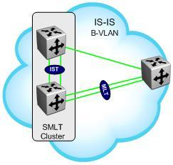
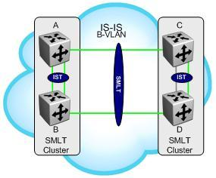
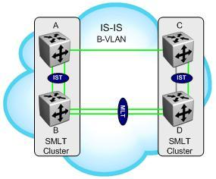
SPBM
SMLT NNI
Triangle
Configure each interface as IS-IS pt-to-pt. If multiple links are required, configure MLT first then configure IS-IS on the MLT
Square
MLT is local on lower
Switch. IS-IS is configured on interfaces (port on upper switch, MLT on lower switch.

Slide 36
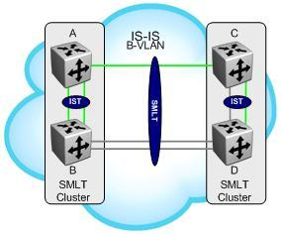
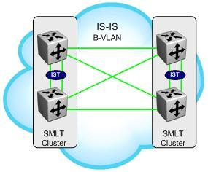
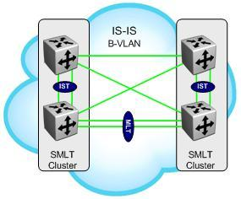
SPBM
SMLT NNI
IS-IS should be configured on only one of the links between B and D
Square
Configure each interface as IS-IS pt-to-pt. If multiple links are required, configure MLT first then IS-IS

Slide 37
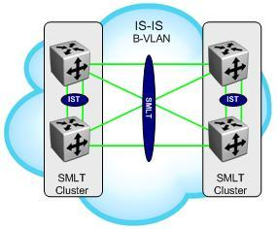
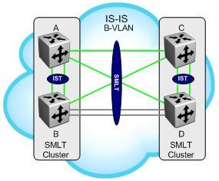
SPBM
SMLT NNI
Configure each interface as IS-IS pt-to-pt
IS-IS should be configured on only one of the links between B and D

Slide 38

SPBM
Hashing
MLT hashing for ingress UNI traffic:
  IP traffic is hashed based on Source_IP, Destination_IP and TCP/UDP port number
  Non-IP traffic is hashed based on Source_CMAC and Destination_CMAC
MLT hashing for ingress NNI (encapsulated) traffic:
  IP traffic is hashed based on Source_IP, Destination_IP
  Non-IP traffic is hashed based on Source_CMAC and Destination_CMAC
NNI
UNI
UNI
NNI
MLT
MLT

Slide 39
SPBM
Equal Cost Multi Tree
Equal Cost Multi Tree (ECMT) in 802.1aq allows for two or more equal cost paths
I-SID hashing:
  Odd I-SIDs take Primary B-VID
  Even I-SIDs take Secondary B-VID
B-VID 40
Primary
I-SID 100
I-SID 101
B-VID 50
Secondary

Slide 40
SPBM Supported Services

Slide 41
SPBM Supported Services
SPB L2 VSN
  Software Support: ERS 8K 7.1, VSP9K 3.2, VSP7K 10.2
  L2 Services over IS-IS
  I-SID to VLAN mapping
IP Shortcuts
  Software Support: ERS 8K 7.1, VSP 9K 3.2
  Using Global Routing Table (over native IS-IS)
  No I-SID mapping
SPB L3 VSN
  Software Support: ERS 8K 7.1, VSP 9K 3.2
  L3 VRF over IS-IS
  I-SID to VRF mapping
Inter-ISID Routing
  Software Support: ERS 8K 7.1, VSP 9K 3.2
  Routing between two or more SPB L2 VSNs
IP Multicast
  Software Support: ERS 8K 7.2
  Dynamic I-SID assignment based on S,G, and I-SID

Slide 42
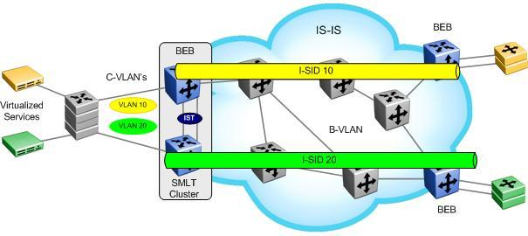
SPBM Supported Services
SPB L2 VSN
An SPB L2 VSN is simply made up of a number of Backbone Edge Bridges used to terminate Layer 2 VSN
  Only BEB bridges are aware of any L2 VSNs and C-MACs
    BCBs only learn B-MACs
  An I-SID is configured on the BEB for each VLAN
    All VLANs in the network that share the same I-SID will be able to participate in the same VSN

Slide 43
SPBM Supported Services
SPB L2 VSN—Continued
TLVs are used to identify SPBM instance, link metric’s, and B-VLAN, B-MAC, number of I-SID’s
  Show isis lsdb detail
  Show isis lsdb tlv 183 detail

Slide 44
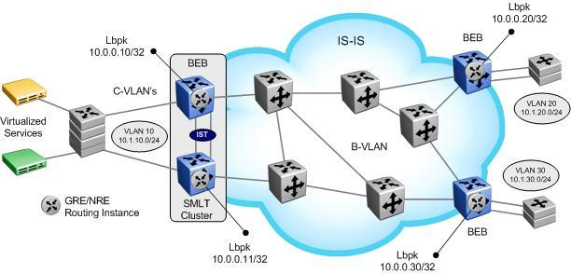
SPBM Supported Services
IP Shortcuts
No I-SIDS used
IP forwarding over IS-IS
ECMP Supported
  IP ECMP must be enabled
Need to enable IS-IS redistribution (direct|rip|ospf|static|BGP)
  IS-IS IP distributed without IS-IS redistribution enable
TLV 135 (Extended IP Reachability) is used between IS-IS peers

Slide 45
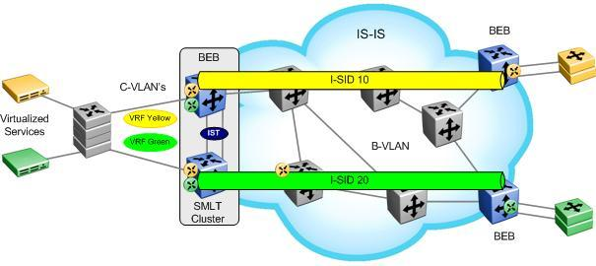
SPBM Supported Services
SPB L3 VSN
L3 VRF over IS-IS
A SPB L3 VSN topology is very similar to a SPB L2 VSN topology with the exception that a Backbone Service Instance Identifier (I-SID) will be assigned at the Virtual Router (VRF) level instead of at a VLAN level
All VRFs in the network that share the same I-SID will be able to participate in the same VPN
The SPBM IPVPN Reachability TLV 184 is used to distribute IPVPN reachability between IS-IS peers

Slide 46
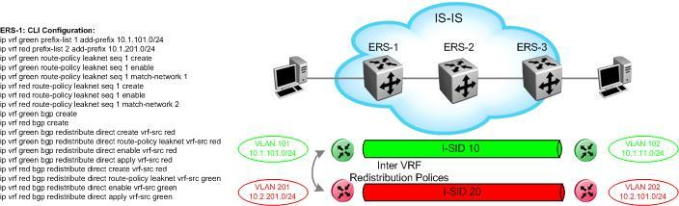
SPBM Supported Services
SPB L3 VSN—Continued
Note, any routing protocol can be used in the redistribution policy

Slide 47
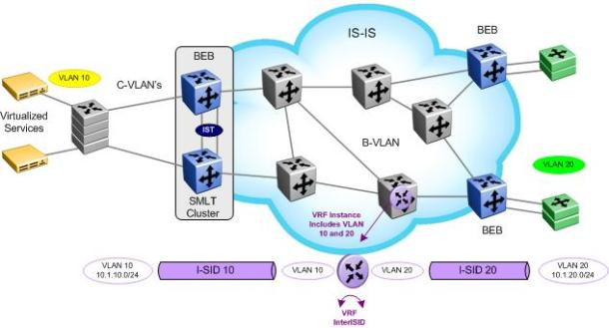
SPBM Supported Services
InterISID Routing
Inter-ISID allows route leaking between two or more VLANs on local BEB switches
  Inter-ISID is typically enabled on a core switch as shown above to route between VLANs from two or more BEB switches
Can be done via VRF as shown above or via IP Shortcuts

Slide 48
@jeffcox65

Slide 49
Backup Slides
SPBM Configuration

Slide 50
SPBM
Configuration
Core configuration – Basic Setup
  Enable SPBM
  Create B-VLAN(s)
    Create two (primary and secondary for ECMT)
  Add SPBM instance (a number from 1 to 100)
  Add Nick-name (x.xx.xx)
  Add B-VLAN(s)
      Add all B-VLANs and set primary B-VLAN
  On a SMLT Cluster
    A Virtual B-MAC must be configured plus IST peering using neighbor System ID
    The Virtual B-MAC must be the same on both cluster switches
  Enable IS-IS on interface level
    Individual port or MLT
      If MLT, create MLT first then enable IS-IS on MLT

Slide 51
SPBM Configuration
IS-IS and SPBM Core Configuration - CLI
CLI
  ERS-8800:5# config spbm enable
  ERS-8800:5# config vlan <B-VLAN: vlan-id> create spbm-bvlan
  ERS-8800:5# config isis spbm <instance-id: 1..100> create
  ERS-8800:5# config isis spbm <1..100> nick-name <x.xx.xx - 2.5 bytes>
  ERS-8800:5# config isis spbm <1..100> add-b-vid <vlan id>
  *Or if two B-VLANs are used
  ERS-8800:5# config isis spbm <1..100> add-b-vid <vlan id,vlan id> primary <vlan id>
  ERS-8800:5# config isis manual-area add <xx.xxxx.xxxx...xxxx - 1...13 bytes>
  ERS-8800:5# config isis enable

Slide 52
SPBM Configuration
IS-IS and SPBM Core Configuration - ACLI
ACLI
  ERS-8800:5(config)#spbm
  ERS-8800:5(config)#vlan create <B-VLAN: vlan-id> type spbm-bvlan
  ERS-8800:5(config)#router isis
  ERS-8800:5(config-isis)#spbm <instance-id: 1..100>
  ERS-8800:5(config-isis)#spbm <1..100> nick-name <x.xx.xx - 2.5 bytes>
  ERS-8800:5(config-isis)#spbm <1..100> b-vid <vlan id>
  *Or if two B-VLANs are used…
  ERS-8800:5(config-isis)#spbm 1 b-vid <vlan id,vlan id> primary <vlan id>
  ERS-8800:5(config-isis)#manual-area <xx.xxxx.xxxx...xxxx - 1...13 bytes>
  ERS-8800:5(config-isis)#exit
  ERS-8800:5(config)#router isis enable

Slide 53
SPBM Configuration
IS-IS and SPBM Interface Configuration - CLI
CLI
  ERS-8800:5# config ethernet <slot/port> isis create
  ERS-8800:5# config ethernet <slot/port> isis spbm <1..100> state enable
  ERS-8800:5# config ethernet <slot/port> isis enable
  *Or if MLT…
  ERS-8800:5# config mlt <mlt id> isis create
  ERS-8800:5# config mlt <mlt id> isis spbm <1..100> state enable
  ERS-8800:5# config mlt <mlt id> isis enable

Slide 54
SPBM Configuration
IS-IS and SPBM Interface Configuration - ACLI
ACLI
  ERS-8800:5(config)#interface gigabitEthernet <slot/port>
  ERS-8800:5(config-if)#isis
  ERS-8800:5(config-if)#isis spbm <1..100>
  ERS-8800:5(config-if)#isis enable
  ERS-8800:5(config-if)#exit
  *Or if MLT…
  ERS-8800:5(config)#interface mlt <mlt id>
  ERS-8800:5(config-mlt)#isis
  ERS-8800:5(config-mlt)#isis spbm <1..100>
  ERS-8800:5(config-mlt)#isis enable
  ERS-8800:5(config-mlt)#exit

Slide 55
SPBM Configuration
Extending a VLAN (L2 VSN)
CLI
  ERS-8800:5# config vlan <vlan-id> i-sid <id: 0..16777215>
ACLI
  ERS-8800:5(config)#vlan i-sid <vlan-id> <i-sid: 0..16777215>

Slide 56
SPBM Configuration
Extending a VLAN (L3 VSN)
CLI
  ERS-8800:5# config ip vrf <vrf-name> create
  ERS-8800:5# config ip vrf <vrf-name> ipvpn create
  ERS-8800:5# config ip vrf <vrf-name> ipvpn i-sid <id: 0..16777215>
  ERS-8800:5# config ip vrf <vrf-name> ipvpn enable
ACLI
  ERS-8800:5(config)#ip vrf <vrf-name> vrfid <1-255>
  ERS-8800:5(config)#router vrf <vrf-name>
  ERS-8800:5(router-vrf)#ipvpn
  ERS-8800:5(router-vrf)#i-sid 1000
  ERS-8800:5(router-vrf)#ipvpn enable
  ERS-8800:5(router-vrf)#exit

Slide 57
SPBM
Adding L3 VPN
I-SID 13990001
8600G
8600A
3/5
3/11
3/2
8600C
3/1
MLT1
3/12
3/3
VLAN 101
IS-IS (SPBM)
4/30
3/21
3/22
3/29
3/30
10.0.101.0/24
MLT 1
IST
4/1
4/20
4/30
3/29
3/30
Tester
4/29
Tester
4/11
3/3
SMLT
4/29
3/1
4/12
3/2
VLAN 102
8600D
8600B
ip vrf green ipvpn create
ip vrf green ipvpn i-sid 13990001
ip vrf green ipvpn enable
ip vrf green isis redistribute direct create
ip vrf green isis redistribute direct enable
ip vrf green isis redistribute direct apply
ip vrf green ipvpn create
ip vrf green ipvpn i-sid 13990001
ip vrf green ipvpn enable
ip vrf green isis redistribute direct create
ip vrf green isis redistribute direct enable
ip vrf green isis redistribute direct apply
ip vrf green ipvpn create
ip vrf green ipvpn i-sid 13990001
ip vrf green ipvpn enable
ip vrf green isis redistribute direct create
ip vrf green isis redistribute direct enable
ip vrf green isis redistribute direct apply

Slide 58
SPBM Configuration
CFM
CLI
  ERS-8800:5# config cfm md <md string> create
  ERS-8800:5# config cfm md <md string> ma <ma string> create
  ERS-8800:5# config cfm md <md string> ma <ma string> mep <mep id> create state enable
  ERS-1:6# config vlan <b-vlan-id> add-nodal-mep <mdName.maName.MEPId,…>
  ERS-1:6# config vlan <b-vlan-id> add-nodal-mip-level <0..7,…>
ACLI
  ERS-8800:5(config)#cfm maintenance-domain <md string>
  ERS-8800:5(config)#cfm maintenance-association <md string> <ma string>
  ERS-8800:5(config)#cfm maintenance-endpoint <md string> <ma string> <mep id> state enable
  ERS-8800:5(config)#vlan nodal-mep <b-vlan-id> <mdName maName MEPId,…>
  ERS-8800:5(config)#vlan nodal-mip-level <b-vlan-id> <0..7,…>

Slide 59
SPBM Configuration
CFM Notes
Notes
  Maintenance Domain (string up to 22 characters)
  Maintenance Association (string up to 22 characters)
  Maintenance end point (id from 1 to 8191)
  There may only be one MEP per SPBM VLAN in the 7.1 release
  CFM is only supported on SPBM VLANs.
  When assigning a Maintenance Intermediate Point (MIP) level to an SPBM VLAN the value may be 0 to 7
  There is only one MIP supported per SPBM VLAN in the 7.1 release.
  It is recommended that MEP and MIP use the same level.
  The MEP level is configured under the Maintenance Domain of a given MEP

