Slide 1
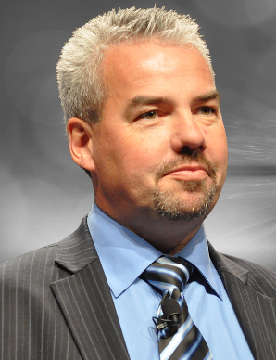



Jean Turgeon
VP World Wide Consultants and Distinguished Solutions Engineering
Avaya
#AvayaATF

Slide 2
Solving Challenges for Business Agility
Doing it Today
#AvayaATF

Slide 3
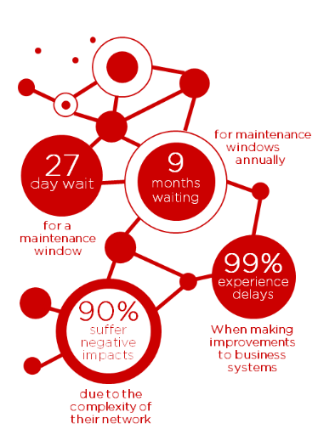
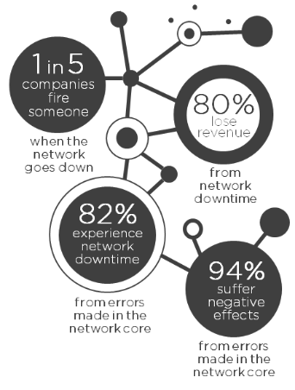

Findings from: Network Agility Research 2014 – Dynamic Markets

Slide 4








Macro Trends
The Market Landscape is Changing Fast
CLOUD
REAL-TIME
COLLABORATION
CONTACT
CONSUMERIZATION
CENTER
MOBILE
SOCIAL
BIG DATA
Notes:
The landscape of enterprise networking is changing fast. +++ People enjoy the conveniences of Cloud Services for many of their needs as consumers, and increasingly expect the same from their Corporate network.
This is why Avaya has transformed itself over the last 18 months, +++ to offer various Cloud based solutions. These can be Private, Public, or Hybrid Solutions. Avaya offers several deployment model choices.
+++ When we talk about Mobility, it is no longer just about providing remote access, it is about Mobile Real Time collaboration. Avaya provides Secure SIP Mobile Collaboration Solutions for Telephony, UC, and Video, with our Sipera SBC. Our portfolio includes Wired and Wireless Solutions, for Campus, Remote Branch, as well as Mobile Workers.
+++ Traditional Contact Centers are evolving fast towards Multi-media Enablement. Customers want integrated interaction, switching between automated Web Chat, and fully interactive Audio and Video sessions. The numerous databases needed to present Call Center Agents with relevant information with regard to +++ Social Media, require an agile and optimized next generation Data Center Architecture. The resulting new traffic patterns demand a new Network infrastructure.
As enterprises deploy Avaya's Solutions, such as Scopia, Flare®, one-X® Mobile, next gen multi-media and social-media enabled Contact Centers, +++ they need to collect a lot of information in order to support real-time Analytics. The trend is to larger data sets due to the additional information This is usually called Big Data.

Slide 5
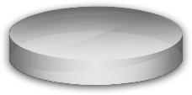
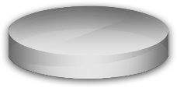
Avaya’s Solutions – A Differentiated Stack
Clients and Devices
Mobile
Clients
Video & Conferencing
Desktop
Video Client
Avaya Messaging Service
Applications & Contact Center
Self-Service
Collaboration Environment
Multi-Channel
Avaya Aura Conferencing
Speech Analytics
Collaboration Platforms
Switched Video & Conferencing
IP Office
Low Bandwidth
High Definition Video
ACA
Session Border Controller
Networking
Multicast &
Video Distribution
Top-of-Rack
High-Availability
Fabric Connect
Identity Engine
Managed Services & Support
UC & CC
Managed Services
SLA Mon
Avaya Diagnostic Server
Avaya
Automated Chat
Notes:
Exactly! Whether your background is in UC or CC, it is important to understand that all Applications within the Avaya Solution Stack can take advantage of Fabric Connect.
Application response time requirements, such as latency and jitter, as well as Quality of Service and Quality of Experience are important. But also the time it takes to deliver a new Service over the Network is crucial for a business.
So just ask the question to your customer, "how quickly does your Enterprise need to be able to deploy these Services to remain competitive", and you will find that Fabric Connect to be the right choice for the majority of corporate networks. When it comes to deployment times, complexity, resiliency and recovery requirements, nobody can beat Avaya Fabric Connect.
So when talking about Avaya's UC and CC Applications, +++ we should not lose sight of the Network. SEs should incorporate Avaya's Fabric Connect as the basis for customer conversations.
Fabric Connect is the core subject of this course. Could we give a quick overview as to what Avaya's Fabric Connect is?
Sure – Fabric Connect is Avaya's Network Architecture. It is based on established networking Standards. The central Standard we employ for this is 'Shortest Path Bridging'. Let's watch a short movie on Fabric Connect. I encourage you to write down some five to ten questions that come to mind while watching the movie.

Slide 6



Why CxO’s consider Cloud / SDN?
MPLS
PIM
BGP
Business
OSPF
MSTP
“Protocols are killing us…
Protocols are like the never-ending bottle of pills, each one prescribed to remedy the problems introduced by the previous medication.”
PIM
RSTP
Network
20 seconds later…
Today’s protocol stacks are like a house of cards
OSPF
The
Protocol
Stack
(a Stack of Protocols)
1.2 seconds later…
MSTP
0.5 seconds later…
RSTP
0.8 seconds later…
802.3
Link comes up…
http://packetpushers.net/does-trill-stand-a-chance-at-wide-adoption/#disqus_thread
Notes:
So, how did we get to this situation..?
We’d all like to think that the network that we’ve chosen is capability of ensuring business continuity and growth; the analogy of the network being a stonewall that provides solid foundations for the business.
But what if you look behind the façade…Conventional network design calls for a series of independent protocols to be stacked on top of each other, each reliant upon the one underneath to provide functionality to the one above; sort of like a House of Cards…
But what happens when this collapses..? Obviously it all comes tumbling down and the Business is left stranded, waiting for everything to be progressively rebuilt…
The actual link may have to come up, and luckily this is normally pretty fast. Then Spanning Tree needs to re-converged, and even Rapid STP take almost a second. And as most networks are running multiple VLANs, we need Multi Spanning Tree to sort itself out; that’s another half a second… So, now that Layer 2 it up, Layer 3 can start to think about converging again; OSPF, if really tuned to the extreme, will take at least a second or two, and then the big wait kicks in, while we wait for PIM to sort itself out… So, 20, 25, 30 seconds, maybe more…
Not so much a stonewall, but more trying to build on a foundation of sand…
Now, if we turn to Avaya’s Fabric Connect technology, part of the VENA networking toolkit, it is differentiated by being one single, unified and integrated protocol, all the way from Layer 2 loop avoidance to IP Multicast…
So, after Link comes up, Fabric Connect’s IS-IS-based Shortest Path Bridging converges almost immediately; and that’s it, this one protocol handles everything: Layer 2, layer 3, and IP Multicast.
This delivers a genuine rock-solid, granite-like foundations.

Slide 7
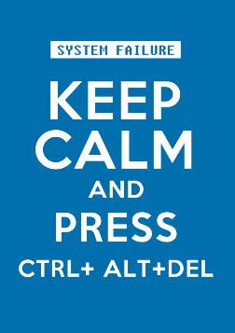
Why This Is A Problem
Perpetuating the status quo may not be good business
Compute consolidation and virtualization mandates a different network…
IT-driven businesses are always-on businesses…
Doing more with less is the new normal…
Resources are finite, demands are not…
Notes:
And given how the rest of IT is evolving, it is obvious that the old-fashion network is no longer good enough.
With all of the consolidation and virtualisation of the compute resources there definitely needs to be a different approach to how the network is provisioned. We can’t spend all that money and all the effort in virtualising compute only for the network to still be operating in what is essentially a client/server mode.
Many businesses now operate around the clock, many businesses are driven by their IT systems and the loss of access to these systems means the loss of the ability to trade.
As we will all understand we are being asked to do more with less than that is really the new reality that we all face; it’s hard to imagine to many companies that provide a blank check when it comes to delivering IT services.
And lastly, resources are finite, especially highly skilled engineering resources, and the demand seem to be never-ending and so anything we can do to rebalance away from mundane maintenance activity and towards genuine value-add is definitely a good thing.

Slide 8
What are Customers saying?
“Previously we… needed a lead time of up to six weeks…; today we can implement similar tasks within days.”
Albert Knoll,
Network Operations Manager, Fujitsu
"We needed to extend services to another data center without any business interruptions, Avaya was the vendor with the most viable solution to meet our needs”
"We had maintenance window to transition services associated with vlans, some were forgotten, but with Fabric Connect we were able to easily extend the one's forgotten, in the past we would have had to re-schedule the changes another weekend and revert back, not this time”
Stuart Russell, Leader Networking Engineering – Westpac/St George Bank
“What Avaya has done with its networking technology at Sochi, I wish I had that in Vancouver, it would have made my life much better”
Ward Chapin,
CIO 2010 Vancouver Olympics

Slide 9

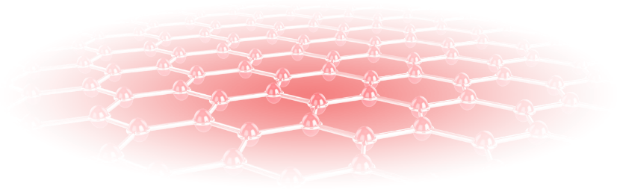

Data Center Architecture
Campus
Building3
Building 4
Building5
ERS
VSP 4000
10GE
10GE
7000/8800/9000
10GE
7000/8800/9000
7000/8800/9000
ERS
VSP 4000
Based on
E-LINE
Provider
Service
VSP 4000
Metro Rings
DC 1
DC 2
ERS
VSP 9000
VSP 9000
Data Center
WAN
MAN
Consistent architecture from Data Center to Campus / Metro to Branch

Slide 10
The Battle of the Ethernet Fabrics..Update!
Application Extensions
IP & IP Multicast Shortcuts
L3 Virtualization
L2 Virtualization
L2 Multi-Pathing
L2 Loop-Free Topology
Avaya VENA
Fabric Connect
(extended SPB)
Root bridge dependent
Large flooding domain
VLAN based virtualization
Protocol stitching for extension across distances
Single logical switch
150m distance limitation (beyond needs MPLS)
VLAN-based virtualization
When?
Which products?
MPLS
OTV
Cisco
Insieme (SDN)
VPLS
HP
(SPB…TRILL…SDN)
Juniper (SDN)
MetaFabric^{tm}
IETF TRILL
Cisco FabricPath
Brocade VCS
Juniper QFabric
X
STP
Notes:
Q-Fabric X

Slide 11

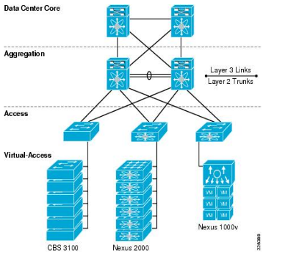
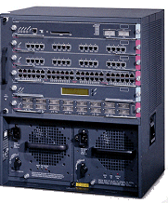





Is this Meeting your Next-Gen Data Center needs?
Complexity, Higher Latency, Proprietary..!!!
Data Center Core
C6x00 VSS Core required
10G only for Active/Active
End-of-Row
(Dual Chassis only)
C4500
C6500

Slide 12


“Data Center Fabric”
Eliminate Topology limitations
ERS 8800/VSP’s
VSP 9000
Fabric Connect
Core
North-South/Core-ToR Interconnects
VSP 7000
Distributed
Data Center
Distributed Top-of-Rack
Stack-mode DToR
Structured Interconnect: 8 Switches / 256 10GbE Ports & 5.12Tbps
16 Switches – Active/Active – 512 10GbE Ports & 10.24Tbps
Fabric-mode DToR
Flexible Interconnect: 200 Switches / 6,400 10GbE Ports & 112Tbps
(10.3 increases scale even more..!)

Slide 13
Next-Gen Campus Architecture
Campus
Building3
Building 4
Building5
ERS
VSP 4000
10GE
10GE
7000/8800/9000
10GE
7000/8800/9000
7000/8800/9000
ERS
VSP 4000
Based on
E-LINE
Provider
Service
VSP 4000
Metro Rings
DC 1
DC 2
ERS
VSP 9000
VSP 9000
Data Center
WAN
MAN
Consistent architecture from Data Center to Campus / Metro to Branch

Slide 14







From Complex, Rigid and Cumbersome Networks
Server Access
Data Center Core
Campus Core
Edge
X
VLAN
VLAN
VLAN
VLAN
VLAN
VLAN
VLAN
X
VLAN
Server
STP
VLAN
VLAN
VLAN
VLAN
STP
VLAN
X
VLAN
VLAN
VLAN
VLAN
VLAN
VLAN
VLAN
VLAN
VLAN
VLAN
VLAN
VLAN
VLAN
Server
OSPF
Static routes
BGP
PIM-SM/DVRMP
VRF
SMLT/RSMLT
VLACP/SLPP
OSPF
Static routes
BGP
PIM-SM/DVRMP
VRF
STP
MSTP
RSTP
FlexLink
SMLT/RSMLT
VLACP/SLPP
STP
MSTP
RSTP
FlexLink
To Simple, Agile and Resilient Networks
Server Access
Data Center Core
Campus Core
Distribution
Edge
VLAN
VLAN
Server
VLAN
VLAN
Server
Fabric Connect: IEEE 802.1aq / RFC 6329
Notes:
This slide shows visually the points that we’ve been making – the huge suite of protocols in today’s networks and how this can be streamlined into one technology with Avaya Fabric Connect. It also shows that instead of having to provision hop by hop the services – which is time consuming and error prone, when we evolve to our Fabric Connect private cloud network - the core of the network is essentially invisible as services are enabled at the edge only. You build the core one time and then you don’t touch it. This is of huge value to the customer because a configuration error in their core can be catastrophic – impacting multiple applications and multiple users. Also designing the network is much easier you can place services whereever you need them rather than being limited to strict design rules.
If we talk specifically about multicast, multicast can be complex to configure you have to configure boot strap routers, rendezvous points… with Fabric Connect all services including multicast are enabled at the edge only. And because we’ve eliminated traditional multicast protocols we eliminate the need for the complex additional configuration.

Slide 15
What This Means In The Real World
Configuring a single Layer 2 VPN (VLAN Extension)
Conventional Networking
Avaya Fabric Connect
set routing-instances RI-IPN-L2L01 instance-type l2vpn
set routing-instances RI-IPN-L2L01 interface ge-0/0/8.700
set routing-instances RI-IPN-L2L01 interface xe-0/2/0.700
set routing-instances RI-IPN-L2L01 route-distinguisher 13.13.13.1:1013
set routing-instances RI-IPN-L2L01 vrf-target target:64999:1013
set routing-instances RI-IPN-L2L01 protocols l2vpn encapsulation-type ethernet-vlan
set routing-instances RI-IPN-L2L01 protocols l2vpn site H15-H15-IPN-L2L01 site-identifier 1
set routing-instances RI-IPN-L2L01 protocols l2vpn site H15-H15-IPN-L2L01 interface xe-0/2/0.700 remote-site-id 11
set routing-instances RI-IPN-L2L01 protocols l2vpn site RH15-H15-IPN-L2L01 site-identifier 11
set routing-instances RI-IPN-L2L01 protocols l2vpn site RH15-H15-IPN-L2L01 interface ge-0/0/8.700 remote-site-id 1
set interfaces ge-0/0/8 unit 700 description L2-IPN-L2L01
set interfaces ge-0/0/8 unit 700 encapsulation vlan-ccc
set interfaces ge-0/0/8 unit 700 vlan-id 613
First device done…now, onto the next...
vlan i-sid 7 700
DONE – end-to-end..!
(Now this might take a while…)
(Actually, we need to speed things up…)
Notes:
Once again you might say ‘that’s all well and good but what does it actually mean for me..?’
So let’s go through and very realistic provisioning scenario. Here we want to create a VLAN extension between two Data Centres; this is a very typical requirements when we want to provide Layer 2 collectivity between servers.
On the left will be doing this in the conventional way using the typical technology of MPLS, and the right will do this using Fabric Connect.
So let’s get going… as you can see it is a very complex, time-consuming, specialised, and risky activity. The key thing, the really crucial thing, is that this level of configuration needs to be executed on each and every device in the path.
Now if we look at the fabric connect alternative your see something dramatically different. Yes that’s it one single simple command on one device at the very edge of the network. No configurations on the Core, no configurations device-by-device, hop-by-hop, or link-by-link. Now I challenge anyone to say that this is not an advancement, that this is not progress…
These two additional take-aways that I’d like to highlight. Firstly which of these two approaches do you think is the more risky..? Thinking back to my first slide where I highlighted all of the issues that conventional networking has around change and risk and error..? And secondly which of these two approaches do you think would integrate more seamlessly to have orchestration at automation solution..?

Slide 16
The Virtual Enterprise – Enterprise-Wide Fabric
Building3
Building 4
Building5
ERS
VSP 4000
10GE
10GE
7000/8800/9000
10GE
7000/8800/9000
7000/8800/9000
ERS
VSP 4000
Based on
E-LINE
Provider
Service
VSP 4000
Metro Rings
DC 1
DC 2
ERS
VSP 9000
VSP 9000
WAN
Campus
MAN
Consistent Architecture From Data Center to Campus / Metro to Branch

Slide 17

Software-Defined Networking
Summarizing the problems that SDN seeks to solve
A⁺
Complexity of (multiple) overlay Protocols
Changes in Applications Architecture
Challenge of Virtual Machine Mobility
Policy and Quality
Multi-Touch Configuration
Scale-Out Connectivity (‘Google Scale’)
Multi-Tenant
Vendor Dependence
Doesn’t SDN or other vendors do that today?
A
A⁺
A
A⁺
A⁺
A⁺
A
Notes:
And speaking of software-defined networking, I assume you have all at least heard of it, although perhaps not too many of you have actually found a way or need to get deploy it.
Here I have distilled the key problems that SDN is meant to be solving; this comes from the Open Network Forum’s own white paper. And many of these are very valid problems, very valid considerations, and certainly things that we should be looking to address.
That we can measure where we are today with Fabric Connect against these aspirational goals for the developing, emerging SDN space…
Clearly, Fabric Connect is delivering against these challenges, delivering today and without requiring an entire churn in technology; Fabric Connect is an evolution of what we have been doing it is an investment of the technologies and techniques that we proven to work, but have simply become old-fashioned and obsolete in the face of advances in other aspects of IT service delivery.
So if simplification, orchestration, and automation are the things that appeal to you from the SDN discussion then come and talk to us and will deliver them for you today with Fabric Connect.

Slide 18




Fundamentally Different, Fundamentally Better
Key advantages:
Physically Managed Control Plane
Autonomic
Control Plane
Network-wide VLAN tagging
Need for sequentially dependent legacy protocols
Network loops
Edge-only provisioning
All links active/optimized
Multicast scale/performance
Easy and unlimited network segmentation
Service
Virtualize devices into one network entity
Service
IP Packets
Services are provisioned on physical devices
Services are provisioned to a single virtual network
Autonomic networking impacts:
IP Packets
Configuration of the Core
Network segmentation
Optimized recovery
IP Multicast Routing
Virtual Machine connectivity
Load-balancing of flows
IP Packets
Notes:
So what does this actually mean..? Fabric Connect might be this great new technology but how does it actually change things on the ground..?
If we look at how networks are actually provisioning will see an important difference. Traditionally, to provision a new servers or to change an existing one, we have to go and touch every device in the service path, configuring each device to ensure that the active and redundant link. And the bigger the network the more complex and risky this becomes. But when we use Fabric Connect to virtualise the network we see a fundamental change. Rather than the network appearing as a mass of individual devices it becomes this opaque cloud, where we only need to touch the single unique device that is providing service directly to the end-point. Fabric connects automatically instantly propagates all of the service attributes to every other node within the cloud. So if we are configuring a server to join an existing VLAN then every other node immediately understands that this connection has been established. Technically, Fabric Connects achieves this by adding a new Ethernet header, this is part of the SPB standard, and it allows every known within the cloud to quickly switch traffic through to the appropriate destination.
It has the added advantage of separating and segmenting traffic to unique service constructs. This is where fabric connects has advantages in delivering solutions which help with compliance for the likes of PCI and HIPAA. We call this capability ‘stealth networking’.
Creating the autonomic network delivers some key advantages. It means that you no longer need to configure the core of the network for every service change; service change is only configured at the age of the network, and this has dramatic impacts for the entire change paradigm. As I’ve mentioned network segmentation means that each service is uniquely encapsulated and carried independent of every other service. Recovery is optimised because we’re leveraging that single unified protocol, and this also includes IP Multicast – Fabric Connect is it industries only solution that delivers seamless scalable and resilience support for IP Multicast. The Edge-only provisioning model delivers significant advances in how the network interacts with VM mobility. Seamless Layer 2 VLANs can easily be extended throughout the Data Centre whether that is a single site or multi-site. And traffic flows are automatically load balanced across all available links.
Some of the key advantages that fabric connect delivers include:
Totally doing away with the need to configure network-wide VLANs
Replacing multiple sequential legacy protocols with this one single unified technology
Totally removing the risk of network loops
Delivering the Edge-only provisioning model which seamlessly integrates with orchestration and automation
And of course all links and all devices are fully optimised enabling you to get the most out of your infrastructure investments

Slide 19

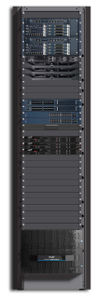





A Full-Stack Solution: Avaya Collaboration Pod
Everything needed for Business Communications
in a pre-integrated, pre-tested, plug and play solution
Integrated management
Gateways
Networking
Applications
Session Border Controllers
Compute
Storage
Integrated support

Slide 20
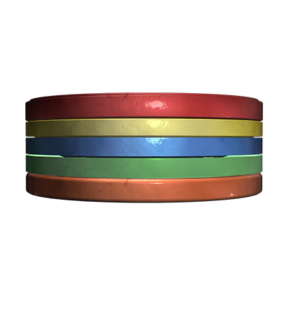
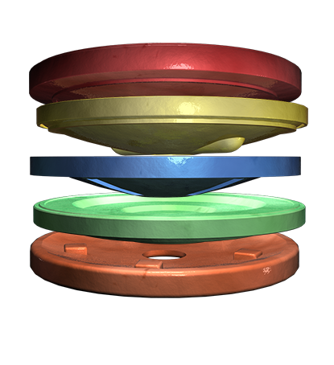
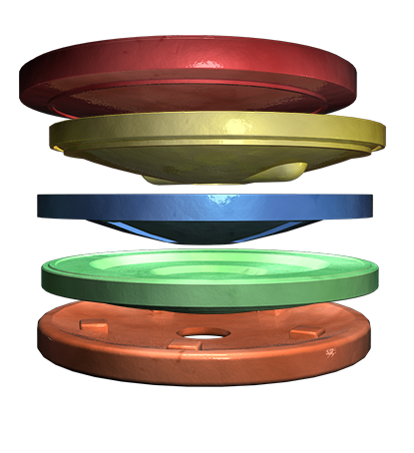
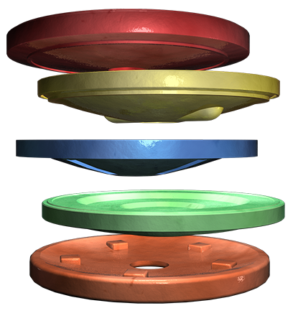
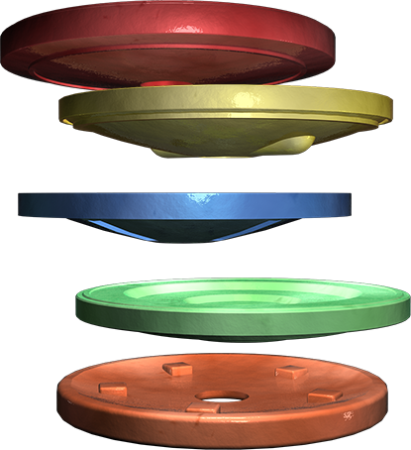

Aligning Communication Elements and Applications
A-Team
Client
1
1. Installed Probes
CC/Applications
3
2. Communication Virtualization
UC/Security
2
3
1
2
3. Middleware Service Brokering
Network
1
Support
Notes:
Slides comes up, shows complexity
Click one: shows probes
Remote access and diagnostics
Client QoS and Awareness
Network Qos
Click two: shows virtualization
Virtualized UC
Virtualized Fabric SW
High Availability Layer 2/3
Latency minimized
Click three: virtualization moves to the left/middleware comes up
Bandwidth Optimized
Commin Admin
High Availability
Policy and Erlang optimized for multichannel
Click four: Middleware moves to the left/enables applications (starts floating around at the client/cc level)
Click five: Org (A team) comes up
Click six: A team moves to the organization/aligned and glow appears

Slide 21
Empowering ‘Networking 2.0’ – “NaaS”
More than just a Spanning Tree replacement
Extends beyond just the Data Center
Accelerates Time-to-Service
Optimizes Data Center interconnect
Native multi-tenancy & network segmentation
Proven interoperability with other vendors
Foundation for a pragmatic SDN strategy
Notes:
So that’s a sense of what Fabric Connect is and how it is so fundamentally different to the conventional networking approach.
It really does change the entire networking landscape it delivers ‘Networking 2.0’.
So very connect is not just a replacement for Spanning Tree like some other alternatives doing the rounds; it is a replacement for multiple interdependent protocols, it is multi-service and that is unique.
Crucially it is designed to go beyond just the Data Centre because applications any users are not confined to just the Data Centre. Businesses are deploying Fabric Connect throughout their entire network landscape from Data Centre, to the Campus, through to the Wiring Closet, and out to the Metro and Branch. And remember this is the same single unified seamless technology deployed into all those areas.
As we saying that we connect allows you to accelerate the time-to-service. We and powerless by removing the requirements to configure a core, with service activation and network change only occurring at the Edge. De-risking change enables it to occur in real-time; you no longer need to have the administrative burden of change management.
Fabric Connect optimises Data Centre interconnectivity both Layer 2 and at Layer 3, and of this optimises application performance and end-user productivity.
It natively supports multi-tenancy and network segmentation, making fabric connects ideal for those scenarios where it needs to be separation between different communities of interest.
Because fabric Connect is an extension of SPB we are uniquely positioned to deliver interoperability; we are leveraging a standard and we are delivering an open solution. And we proved this capability with a multi vendor interoperability test at last years Interop event in Las Vegas. Indeed via delivered the entire Interop backbone for the Las Vegas and New York shows and will be doing it again this year. Because of its agility Fabric Connect is becoming a technology of choice for deployment scenarios that see a high churn rate.
And finally given the simplicity of configuration and the Edge-only provisioning model, Fabric Connect provides an excellent foundation for a software-defined networking strategy.

Slide 22
With Avaya’s Fabric Connect you can…
20x or more
Faster
Time-to-Service
Up to 100x
Faster Applications Delivery
16M+
Unique services
Make more Money $$$
100%
Secure Compliance
(PCI)
100%
Standards based
Interoperability
100x better
Business Continuity & Disaster Recovery
Protect your Investments
Save costs &
reduce risks
Up to 10x
Less Resources
0
Core changes
100%
Public Safety focus
Up to 10x
More Video cameras
Digital signage
10 sec
To Secure
BYOD
Up to 50x
Improved QoE for IPTV viewers
Implement New & Better Services

Slide 23
The Demo Wall
Real Solutions Real Business Value

Slide 24
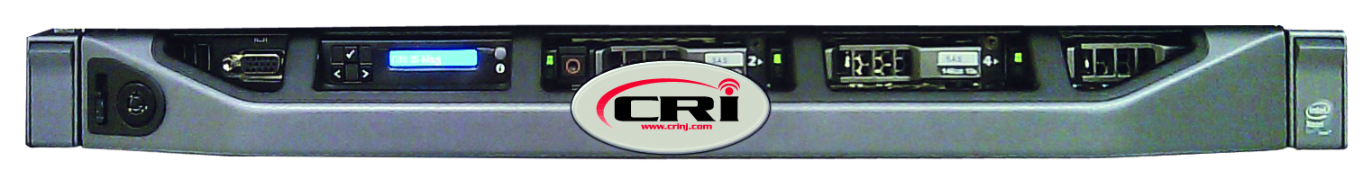
What Do You Get When You…
vSAN
CRI IS Aura
Combine
  CRI
  New VMware technology - vSAN
      Software Defined Storage
  Avaya Aura – SIP connect
  Avaya Networking – Fabric Connect
  Really Smart Engineers at ATF!
@CRIheadlines

Slide 25


A Really Cool Demo of Business Continuity
Not Disaster + Recovery…….. You get Communication Continuity
Virtual SAN across the Fabric Connect
No single failure will bring you down
Active calls will even stay up!
CRI IS Aura
CRI IS Aura
vSAN
vSAN
@CRIheadlines

Slide 26
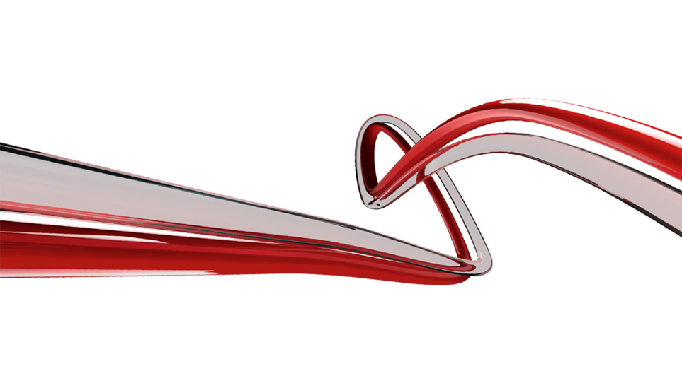


Jean Turgeon (JT)
VP, Worldwide Solutions Engineering
jturgeon@avaya.com
Thank
You!
#AvayaATF

