Slide 1
Managing an Avaya Fabric Connect Solution
Don Rumford
Sr. Consulting Systems Engineer
Avaya Network Management & Access Control Solutions
#AvayaATF

Slide 2

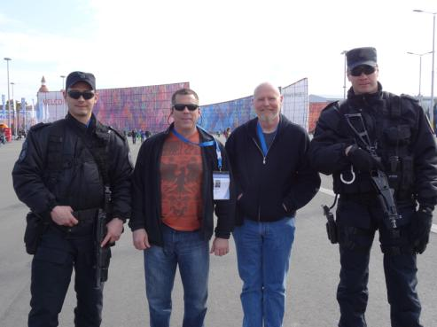



Managing an Avaya Fabric Connect Solution
If you aren’t managing your network you could find yourself in between a rock and a hard place!

Slide 3
What kind of management are we talking about?
It is important to understand that there are different types of network management. The ITU developed the FCAPS model for discussing management generically. The ISO adopted this model as well. An Avaya best practice is to know where each of the available tools fit into this model.
Fault
Configuration
Accounting
Performance
Security
Where do Avaya products fit?
VPFM
COM
VPS
CDR
Apps.
VPFM
IDE
CLI
EDM
CLI
IPFM
CLI
CLI
SLAMon
EDM
CLI
Notes:
Prod = Product
EM = Element Manager
ACM = Avaya Communication Manager Web Pages
AIM = Avaya Integrated Management
SMGR = System Manager
VPFM = Visualization Performance Fault Manager
OIS = Operational Intelligence Suite
FCAPS = Fault, Configuration, Accounting, Performance and Security

Slide 4
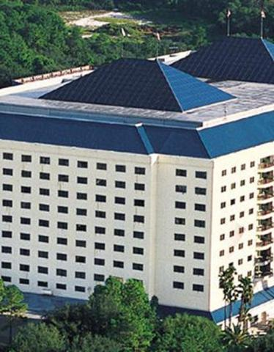
Agenda Overview of the Types of Management
SPB Configuration Management
CLI Methods
Graphical methods
SPB Fault Management
CLI Methods
Graphical Methods
SPB Performance Management
CLI Methods
Graphical Methods

Slide 5




SPB Terminology Review
UNI
NNI
VSN
NNI
UNI
CVLAN
CVLAN
BVLAN
BEB
BCB
BEB
Customer VLAN (CVLAN)
A traditional VLAN with MAC learning & flooding where user devices connect to
Backbone Edge Bridge (BEB)
SPB node where VSN service terminates
BEB node performs 802.1ah MACinMAC encapsulation/de-capsulation for the VSN
BEB is involved in VSN addressing
User Network Interface (UNI)
Interface connected to User Network
Backbone VLAN (BVLAN or BVID)
Special VLAN where MAC table populated by IS-IS shortest path calculations
Provides reachability to EVERY BMAC in the SPB network
Backbone Core Bridge (BCB)
SPB node which does not terminate VSN service
BCB performs forwarding only by looking at outer BMAC header
BCB is unaware of service networks it transports
Network to Network Interface (NNI)
Interface connected to SPBM network
Connectivity Fault Management (CFM)
Toolset for managing connectivity within an SPB environment

Slide 6
Configuration Management
CLI Methods

Slide 7
SPBM Configuration
Core configuration – Basic Setup
Enable SPBM
Create B-VLAN(s)
i.e. for SMLT, create two (primary and secondary)
Do not add port members
Add SPBM instance (a number from 1 to 100)
Add Nick-name (x.xx.xx)
Add B-VLAN(s) –
Add all B-VLANs and set primary B-VLAN, i.e. for SMLT configurations
If SMLT cluster, add SMLT virtual B-MAC
If SMLT cluster, add SMLT peer B-MAC
On a SMLT Cluster
A Virtual B-MAC must be configured plus IST peering using neighbor Sys-ID
The Virtual B-MAC must be the same on both cluster switches
Enable IS-IS on interface level
Individual port or MLT
If MLT, create MLT first then enable IS-IS on MLT

Slide 8
SPBM Configuration IS-IS and SPBM Core Configuration - CLI
CLI
ERS-8800:5# config spbm enable
ERS-8800:5# config vlan <B-VLAN: vlan-id> create spbm-bvlan
ERS-8800:5# config isis spbm <instance-id: 1..100> create
ERS-8800:5# config isis spbm <1..100> nick-name <x.xx.xx - 2.5 bytes>
ERS-8800:5# config isis spbm <1..100> add-b-vid <vlan id>
or if two B-VLANs are used
ERS-8800:5# config isis spbm <1..100> add-b-vid <vlan id,vlan id> primary <vlan id>
ERS-8800:5# config isis manual-area add <xx.xxxx.xxxx...xxxx - 1...13 bytes>
ERS-8800:5# config isis enable

Slide 9
SPBM Configuration IS-IS and SPBM Core Configuration - ACLI
ACLI
ERS-8800:5(config)#spbm
ERS-8800:5(config)#vlan create <B-VLAN: vlan-id> type spbm-bvlan
ERS-8800:5(config)#router isis
ERS-8800:5(config-isis)#spbm <instance-id: 1..100>
ERS-8800:5(config-isis)#spbm <1..100> nick-name <x.xx.xx - 2.5 bytes>
ERS-8800:5(config-isis)#spbm <1..100> b-vid <vlan id>
or if two B-VLANs are used
ERS-8800:5(config-isis)#spbm 1 b-vid <vlan id,vlan id> primary <vlan id>
ERS-8800:5(config-isis)#manual-area <xx.xxxx.xxxx...xxxx - 1...13 bytes>
ERS-8800:5(config-isis)#exit
ERS-8800:5(config)#router isis enable

Slide 10
SPBM Configuration IS-IS and SPBM Interface Configuration - CLI
CLI
ERS-8800:5# config ethernet <slot/port> isis create
ERS-8800:5# config ethernet <slot/port> isis spbm <1..100> state enable
ERS-8800:5# config ethernet <slot/port> isis enable
ERS-8800:5# config mlt <mlt id> isis create
ERS-8800:5# config mlt <mlt id> isis spbm <1..100> state enable
ERS-8800:5# config mlt <mlt id> isis enable

Slide 11
SPBM Configuration IS-IS and SPBM Interface Configuration - ACLI
ACLI
ERS-8800:5(config)#interface gigabitEthernet <slot/port>
ERS-8800:5(config-if)#isis
ERS-8800:5(config-if)#isis spbm <1..100>
ERS-8800:5(config-if)#isis enable
ERS-8800:5(config-if)#exit
ERS-8800:5(config)#interface mlt <mlt id>
ERS-8800:5(config-mlt)#isis
ERS-8800:5(config-mlt)#isis spbm <1..100>
ERS-8800:5(config-mlt)#isis enable
ERS-8800:5(config-mlt)#exit

Slide 12
L2 VSN Config - CLI
vlan 10
L2 VSN I-SID 20010
vlan 10
8600C
8600G
8600D
IS-IS Area 49.0000
4/1
MLT 1
MLT 1
4/1
vlan create 10 type port
vlan members add 10 4/1
vlan i-sid 10 20010
vlan create 10 type port
vlan members add 10 4/1
vlan i-sid 10 20010
Could not be more simple !

Slide 13
SPBM Configuration Extending a VLAN (L2 VSN)
CLI
ERS-8800:5# config vlan <vlan-id> i-sid <id: 0..16777215>
ACLI
ERS-8800:5(config)#vlan i-sid <vlan-id> <i-sid: 0..16777215>

Slide 14

L3 VSN - Config - CLI
vlan 101 10.1.101.0/24
L3 VSN I-SID 30001
vlan 102 10.1.102.0/24
8600C
8600G
8600D
IS-IS Area 49.0000
4/1
MLT 1
MLT 1
4/1
ip vrf green vrfid 1
vlan create 101 type port
vlan members add 101 4/1
interface vlan 101
ip vrf green
ip address 10.1.101.1 255.255.255.0
exit
router vrf green
ipvpn
i-sid 30001
ipvpn enable
isis redistribute direct
isis redistribute direct enable
exit
isis apply redistribute direct vrf green
ip vrf green vrfid 1
vlan create 102 type port
vlan members add 102 4/1
interface vlan 102
ip vrf green
ip address 10.1.102.1 255.255.255.0
exit
router vrf green
ipvpn
i-sid 30001
ipvpn enable
isis redistribute direct
isis redistribute direct enable
exit
isis apply redistribute direct vrf green

Slide 15
SPBM Configuration Extending a VLAN (L3 VSN)
CLI
ERS-8800:5# config ip vrf <vrf-name> create
ERS-8800:5# config ip vrf <vrf-name> ipvpn create
ERS-8800:5# config ip vrf <vrf-name> ipvpn i-sid <id: 0..16777215>
ERS-8800:5# config ip vrf <vrf-name> ipvpn enable
ACLI
ERS-8800:5(config)#ip vrf <vrf-name> vrfid <1-255>
ERS-8800:5(config)#router vrf <vrf-name>
ERS-8800:5(router-vrf)#ipvpn
ERS-8800:5(router-vrf)#i-sid 1000
ERS-8800:5(router-vrf)#ipvpn enable
ERS-8800:5(router-vrf)#exit

Slide 16
SPBM Configuration Displaying your Configuration
Show Commands for ISIS/SPB Basic - ACLI
show isis spbm
show isis
show isis lsdb
show isis interface
show isis adjacencies
show isis system-id
show isis manual-area
show isis spbm unicast-fib
show isis spbm unicast-fib vlan <xxxx> (BVID)
show isis spbm unicast-tree <xxxx> (BVID)
show isis spbm multicast-fib
show isis spbm ip-unicast-fib
show isis spbm ? [For Additional Commands]

Slide 17
Configuration Management
Graphical Methods

Slide 18
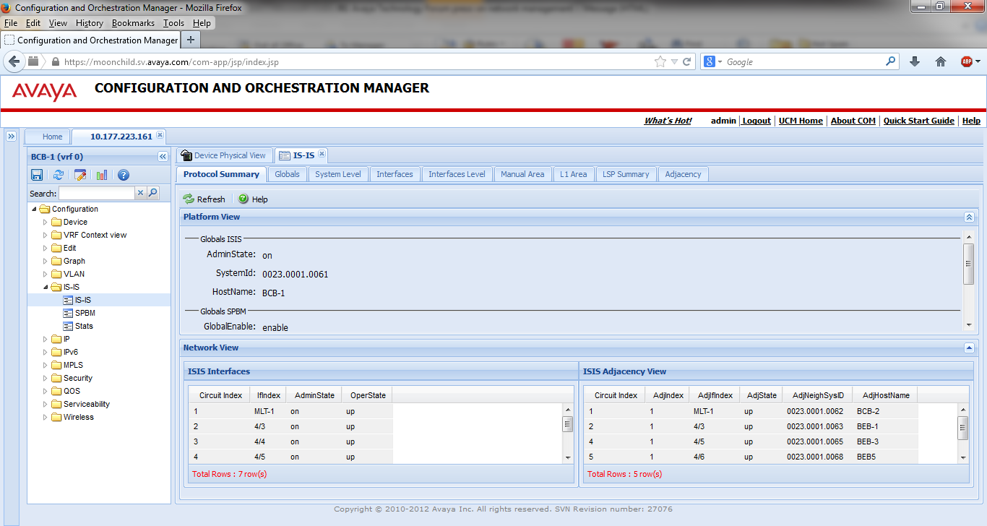
Enterprise Device Manager IS-IS

Slide 19
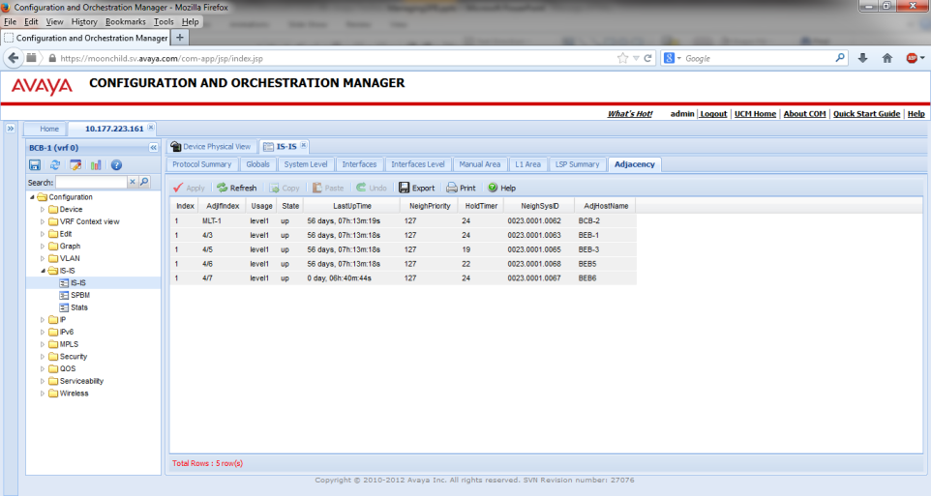
Enterprise Device Manager IS-IS

Slide 20
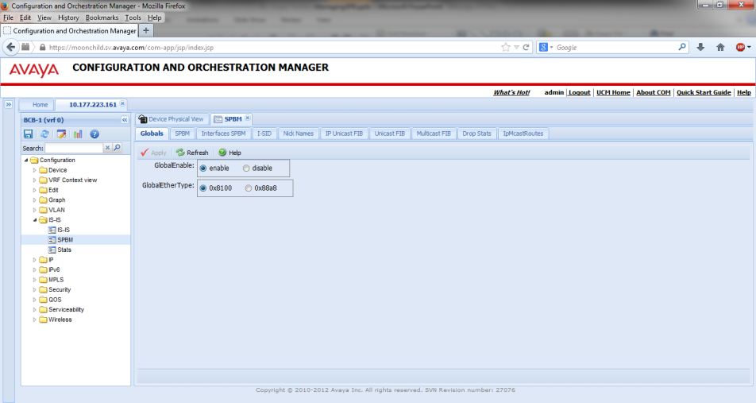
Enterprise Device Manager SPBM

Slide 21
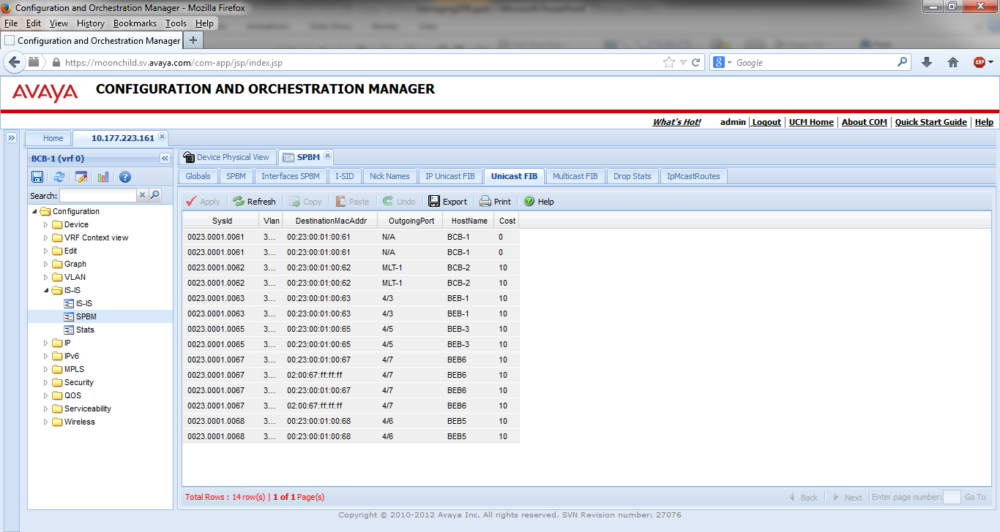
Enterprise Device Manager SPBM

Slide 22
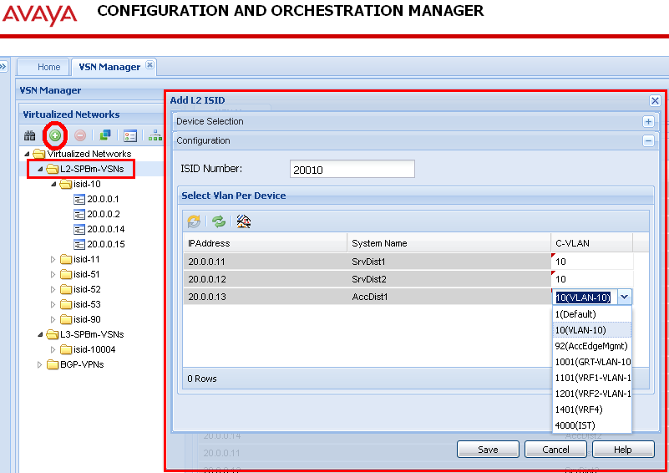
L2 VSN Config – COM VSN Manager

Slide 23
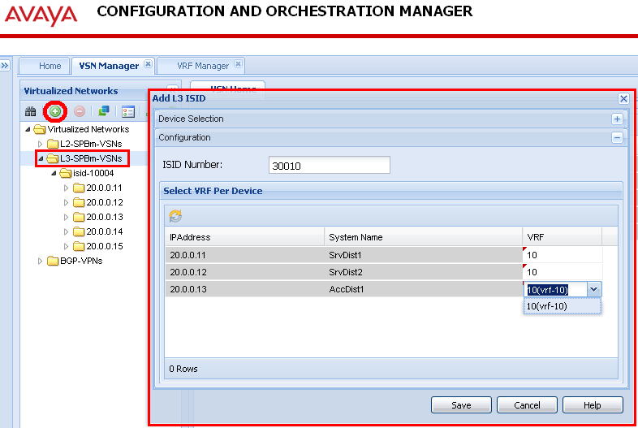
L3 VSN Config – COM VSN Manager

Slide 24
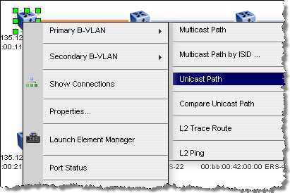
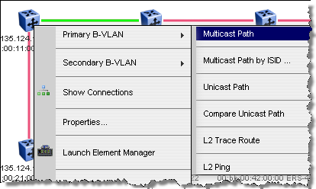
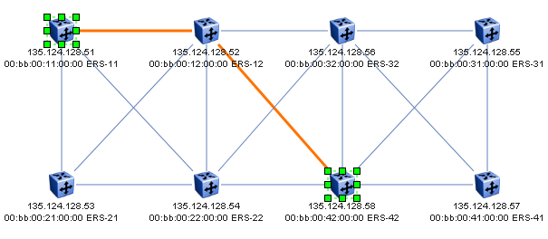
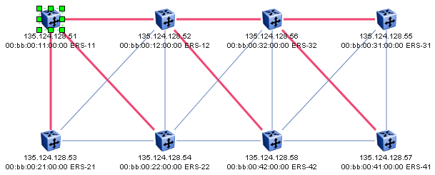
COM VSN Manager
Graphical Visualisation of unicast and multicast trees

Slide 25
Fault Management
CLI Methods

Slide 26
IEEE 802.1ag Connectivity Fault Management (CFM) 802.1ag
Connectivity Fault Management (CFM) offers loopbacks and link trace for troubleshooting, and continuity checks for fast fault detection.
CFM allows operators, service providers and customers to verify the connectivity that they provide or utilize and the connectivity that is provided to them. This is accomplished through:
Periodic messaging between endpoints within a domain for the purpose of fault identification. (CCM)
Loopback (aka L2 ping) messaging to an intermediate or endpoint within a domain for the purpose of fault verification. (LBM)
Linktrace (aka L2 trace) messaging to a maintenance endpoint with intermediate points responding to indicate the path of the traffic within a domain for the purpose of fault isolation. (LTM)

Slide 27
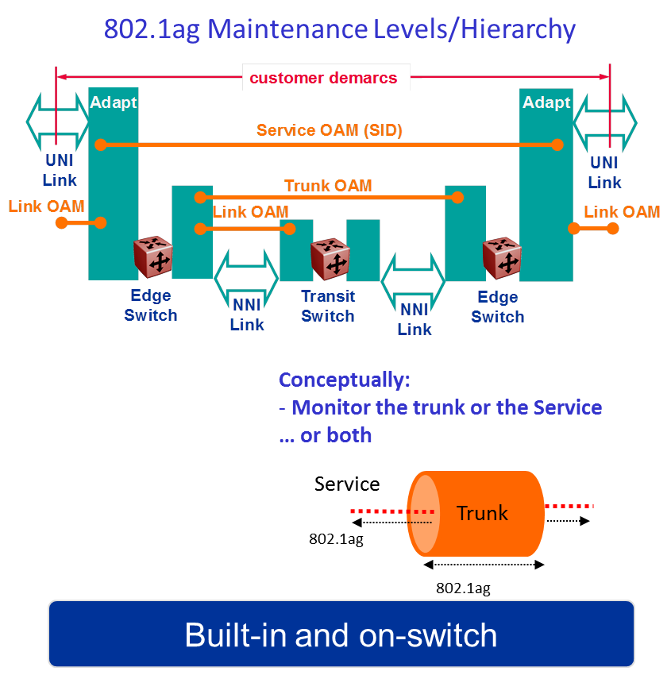
IEEE 802.1ag CFM – Connectivity Fault Management and ITU Y.1731 Performance Management
802.1ag CFM
Maintenance hierarchies
Layer 2 Ping
Layer 2 Traceroute
Layer 2 Tracetree
Layer 2 Tracemroute
CFM Level Hierarchies
Service (e.g., all BEBs supporting common service instance)
CMAC CFM (use level 6 or 7)
Network (e.g. all devices common to a domain)
SPBM CFM (use level 4 or 5)
Y.1731 Performance Monitoring
Frame Delay
Frame Delay Variation
Frame Loss

Slide 28
IEEE 802.1ag Connectivity Fault Management
Maintenance Domain – MD
MD are management space on a network, typically owned and operated by a single entity MD are configured with Names and Levels, where the eight levels range from 0 to 7.
Hierarchal relationship exists between domains based on levels.
CUSTOMER
ETHERNET ACCESS
CORE
ETHERNET ACCESS
CUSTOMER
Customer level (7)
Provider level (3)
Provider level (1)
Provider level

Slide 29
IEEE 802.1ag Connectivity Fault Management
Maintenance Association
Maintenance Association (MA) is “A set of MEPs, all of which are configured with the same MAID (Maintenance Association Identifier) and MD Level, each of which is configured with a MEPID unique within that MAID and MD Level, and all of which are configured with the complete list of MEPIDs”
Maintenance End Point
Maintenance End Point (MEP), are Points at the edge of the domain, define the boundary for the domain A MEP sends and receives CFM frames through the relay function, drops all CFM frames of its level or lower that come from the wire side
Maintenance Intermediate Point
Maintenance Intermediate Point (MIP), are Points internal to a domain, not at the boundary. CFM frames received from MEPs and other MIPs are cataloged and forwarded, All CFM frames at a lower level are stopped and dropped. MIPs are Passive points, respond only when triggered by CFM trace route and loop-back messages
Example: Maintenance Domain = Ottawa, Maintenance Association = 40 (selected 40 to coincide with B-VLAN 40, MEP = 1 (1 associated with switch ERS-1; can be same or unique per switch)

Slide 30
IEEE 802.1ag Connectivity Fault Management
ERS-1# show config module cfm
#
# MAINTENANCE-DOMAIN CONFIGURATION
#
cfm md "Ottawa" create index 1
#
# MAINTENANCE-ASSOCIATION CONFIGURATION
#
cfm md "Ottawa" ma "40" create index 1
cfm md "Ottawa" ma "41" create index 2
#
# MAINTENANCE-ENDPOINT CONFIGURATION
#
cfm md "Ottawa" ma "40" mep 1 create state enable
cfm md "Ottawa" ma "41" mep 1 create state enable
#
# VLAN NODAL MEP/MIP CONFIGURATION
#
vlan 40 add-nodal-mep Ottawa.40.1
vlan 41 add-nodal-mep Ottawa.41.1
ERS-1# show cfm mep info
================================================================================
Maintenance Endpoint Config
================================================================================
DOMAIN ASSOCIATION MEP ADMIN
NAME NAME ID
--------------------------------------------------------------------------------
Ottawa 40 1 enable
Ottawa 41 1 enable
Total number of MEP entries: 2.
================================================================================
Maintenance Endpoint Service
================================================================================
DOMAIN_NAME ASSN_NAME MEP_ID TYPE SERVICE_DESCRIPTION
--------------------------------------------------------------------------------
Ottawa 40 1 nodal Vlan 40, Level 4
Ottawa 41 1 nodal Vlan 41, Level 4

Slide 31
SPBM Configuration Connectivity Fault Management (CFM)
CLI
ERS-8800:5# config cfm md <md string> create
ERS-8800:5# config cfm md <md string> ma <ma string> create
ERS-8800:5# config cfm md <md string> ma <ma string> mep <mep id> create state enable
ERS-1:6# config vlan <b-vlan-id> add-nodal-mep <mdName.maName.MEPId,…>
ERS-1:6# config vlan <b-vlan-id> add-nodal-mip-level <0..7,…>
ACLI
ERS-8800:5(config)#cfm maintenance-domain <md string>
ERS-8800:5(config)#cfm maintenance-association <md string> <ma string>
ERS-8800:5(config)#cfm maintenance-endpoint <md string> <ma string> <mep id> state enable
ERS-8800:5(config)#vlan nodal-mep <b-vlan-id> <mdName maName MEPId,…>
ERS-8800:5(config)#vlan nodal-mip-level <b-vlan-id> <0..7,…>
Notes
Maintenance Domain (string up to 22 characters)
Maintenance Association (string up to 22 characters)
Maintenance end point (id from 1 to 8191)
There may only be one MEP per SPBM VLAN in the 7.1 release
CFM is only supported on SPBM VLANs.
When assigning a Maintenance Intermediate Point (MIP) level to an SPBM VLAN the value may be 0 to 7
There is only one MIP supported per SPBM VLAN in the 7.1 release.
It is recommended that MEP and MIP use the same level.
The MEP level is configured under the Maintenance Domain of a given MEP

Slide 32
IEEE 802.1ag Connectivity Fault Management
There are 5 message types for CFM
Continuity Check Message (CCM) – Not implemented.
Loopback Message (LBM)
Loopback Reply (LBR)
Linktrace Message (LTM)
Linktrace Reply (LTR)

Slide 33

IEEE 802.1ag Message Types
Loopback Message (LBM) & Loopback Reply (LBR)
Ping-like functionality
Linktrace Message (LTM) & Linktrace Reply (LTR)
Traceroute & Tracetree & Tracemroute functionality
Continuity Check Message (CCM)
Data plane fast detection of connectivity failures
* Future software release
LBM
MEP
MEP
LBR
LTM
MEP
MIP
MIP
MEP
LTR
LTR
LTR
CCM
MEP
MEP
CCM

Slide 34
IEEE 802.1ag Connectivity Fault Management
ERS-1# l2ping 40.ERS-3 (B-VLAN.Remote Switch Name)
Please wait for l2ping to complete or press any key to abort
----00:be:b0:00:00:03 L2 PING Statistics---- 0(68) bytes of data
1 packets transmitted, 1 packets received, 0.00% packet loss
round-trip (us) min/max/ave/stdv = 490/490/490.00/ 0.00
ERS-1# l2traceroute 40.ERS-3 (B-VLAN.Remote Switch Name)
Please wait for l2traceroute to complete or press any key to abort
l2traceroute to ERS-3 (00:be:b0:00:00:03), vlan 40
0 ERS-1 (00:be:b0:00:00:01)
1 ERS-3 (00:be:b0:00:00:03)
ERS-1:5# l2tracetree 40.1000 (B-VLAN.I-SID; CFM must be configured on all BEB/PBB switches, make sure MIP level configured, vlan <b-vlan> add-nodal-mip-level <0-7>)
Please wait for l2tracetree to complete or press any key to abort
l2tracetree to 03:00:01:00:03:e8, vlan 40 i-sid 1000 nickname 0.00.01 hops 64
1 ERS-1 00:be:b0:00:00:01 -> ERS-2 00:be:b0:00:00:02

Slide 35

CFM CMAC – L2ping & L2traceroute
I-SID 20010
00:15:e8:9f:e3:de
00:14:0d:a0:13:de
vlan 10
vlan 10
8600C
8600G
8600D
Tester
Tester
8600C:5# show cfm cmac info
====================================================
Cfm Cmac
====================================================
LEVEL ADMIN MEP ID MAC
----------------------------------------------------
6 enable 13 00:15:e8:9f:e3:de
8600D:5# show cfm cmac info
====================================================
Cfm Cmac
====================================================
LEVEL ADMIN MEP ID MAC
----------------------------------------------------
6 enable 14 00:14:0d:a0:13:de
8600C:5# l2ping 10.00:14:0d:a0:13:de
----00:14:0d:a0:13:de L2 PING Statistics---- 0(64) bytes of data
1 packets transmitted, 1 packets received, 0.00% packet loss
round-trip (us) min/max/ave/stdv = 5446/5446/5446.00/ 0.00
8600C:5# l2traceroute 10.00:14:0d:a0:13:de
l2traceroute to (00:14:0d:a0:13:de), vlan 10
0 00:15:e8:9f:e3:de (00:15:e8:9f:e3:de)
1 00:14:0d:a0:13:de (00:14:0d:a0:13:de)
On a VLAN with no IP address, the chassis MAC (with ‘de’ as last byte) is used

Slide 36

CFM SPBM – L2ping & L2traceroute
8600G
8600A
Split-BEB Primary
3/5
3/11
3/2
BVID#1: 4051
8600C
3/1
MLT1
MLT1
3/12
3/3
4/30
3/21
3/22
3/29
3/30
IST
4/1
4/20
4/30
3/29
3/30
Tester
4/29
Tester
4/11
3/3
SMLT
4/29
3/1
4/12
3/2
MLT30
8600D
8600B
8600A:6# l2ping 4051.8600C
----00:15:e8:9f:e3:df L2 PING Statistics---- 0(68) bytes of data
1 packets transmitted, 1 packets received, 0.00% packet loss
round-trip (us) min/max/ave/stdv = 694/694/694.00/ 0.00
8600A:6# l2traceroute 4051.8600C
l2traceroute to 8600C (00:15:e8:9f:e3:df), vlan 4051
0 8600A (00:e0:7b:b4:b3:df)
1 8600G (00:0e:62:25:a3:df)
2 8600C (00:15:e8:9f:e3:df)
SMLT Split-BEB Primary will always use the primary BVID Here = BVID 4051

Slide 37
CFM SPBM – L2tracetree
L2VSN I-SID 20010
I-SID 20010 is even will use BVID#2: 4052
8600G
8600A
3/5
3/11
3/2
8600C
3/1
MLT1
VLAN 10
MLT1
3/12
3/3
4/30
3/21
3/22
3/29
3/29
IST
IST
4/1
4/20
4/30
3/30
3/30
Tester
4/29
Tester
4/11
3/3
SMLT
4/29
3/1
4/12
3/2
VLAN 10
MLT30
8600D
8600B
8600C:5# l2tracetree 4052.20010
l2tracetree to f3:00:13:c6:36:3a, vlan 4052 i-sid 20010 nickname f.00.13 hops 64
1 8600C 00:15:e8:9f:e3:df -> 8600D 00:14:0d:a0:13:df
2 8600D 00:14:0d:a0:13:df -> 8600A 00:e0:7b:b4:b3:df
2 8600D 00:14:0d:a0:13:df -> 8600B 00:0f:cd:57:e3:df
Test connectivity for the multicast tree for a given service instance

Slide 38
Fault Management
Graphical Methods

Slide 39
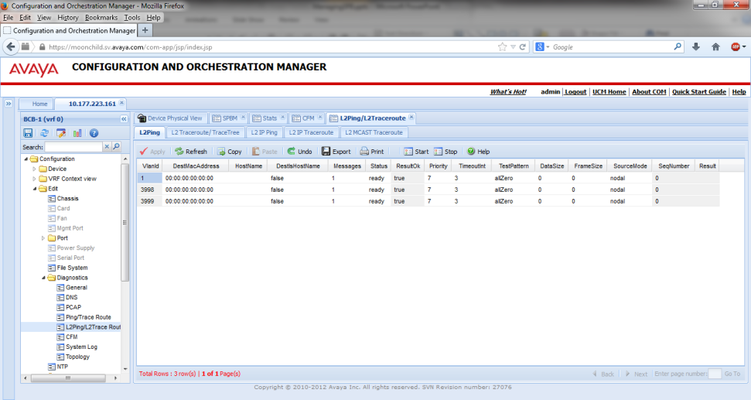
CFM Commands in EDM

Slide 40
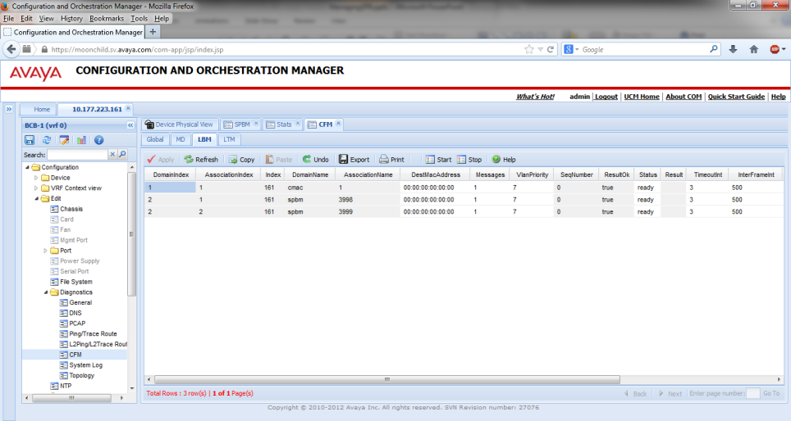
CFM Commands in EDM

Slide 41
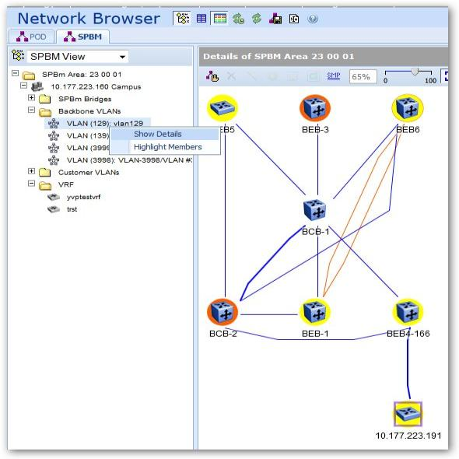
Proactive Fault Management in VPFM

Slide 42
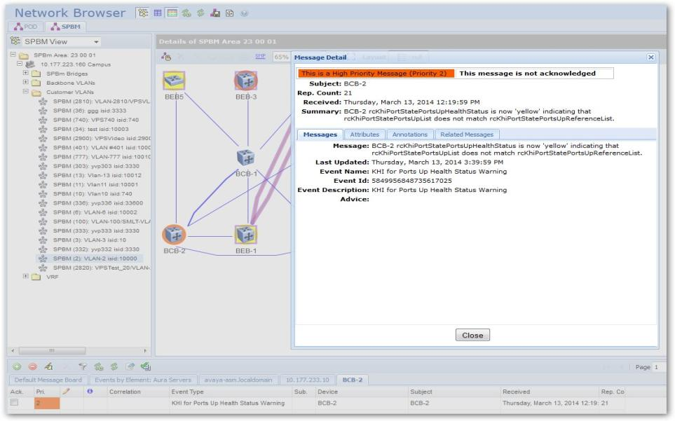
Proactive Fault Management in VPFM

Slide 43
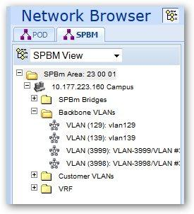
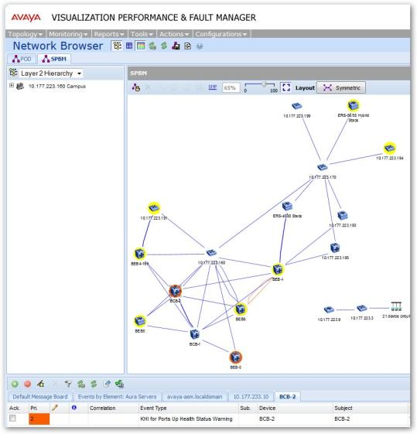
Proactive Fault Management in VPFM

Slide 44
Performance Management
CLI Methods

Slide 45
SPBM Configuration Connectivity Fault Management (CFM)
CLI
show ip isis int-counters
show ip isis int-l1-cntl-pkts
show ip isis int-l2-cntl-pkts
show ip isis int-timers
show ip isis stats
ACLI
show isis spbm drop-stats port last drop
show isis spbm drop-stats port rpfc-multicast-sa
show isis spbm show-all

Slide 46
Performance Management
Graphical Methods

Slide 47
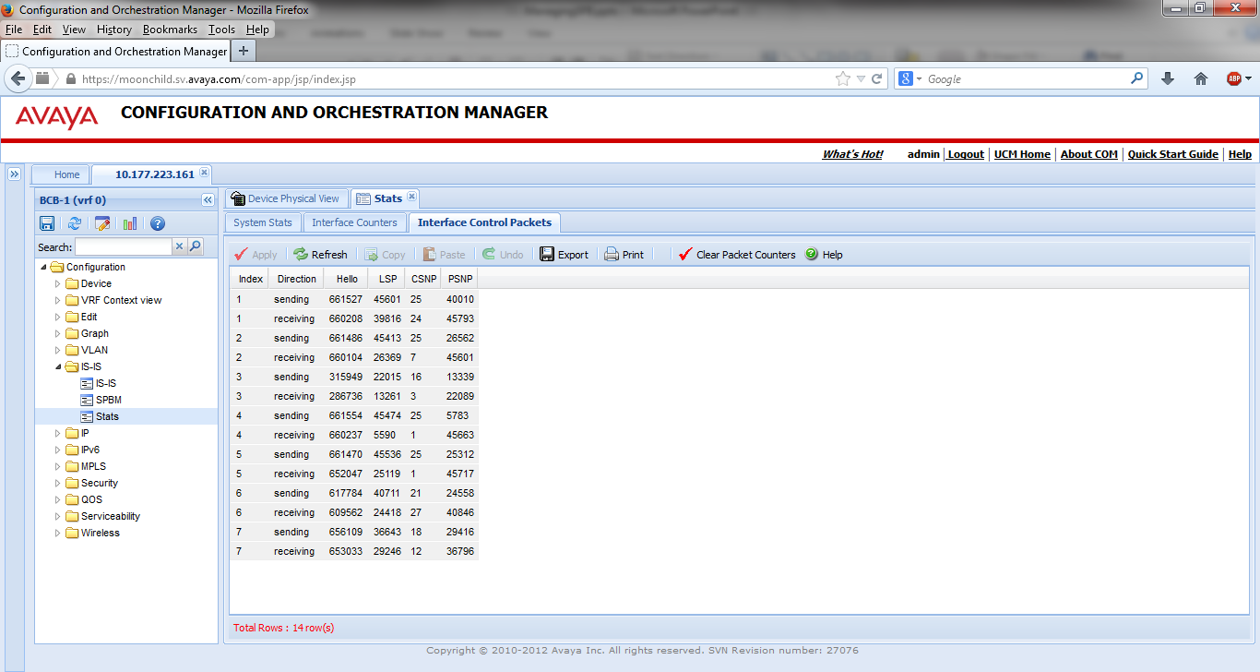
SPB Performance Metrics in EDM

Slide 48
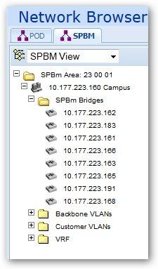
SPB Performance Metrics in VPFM

Slide 49
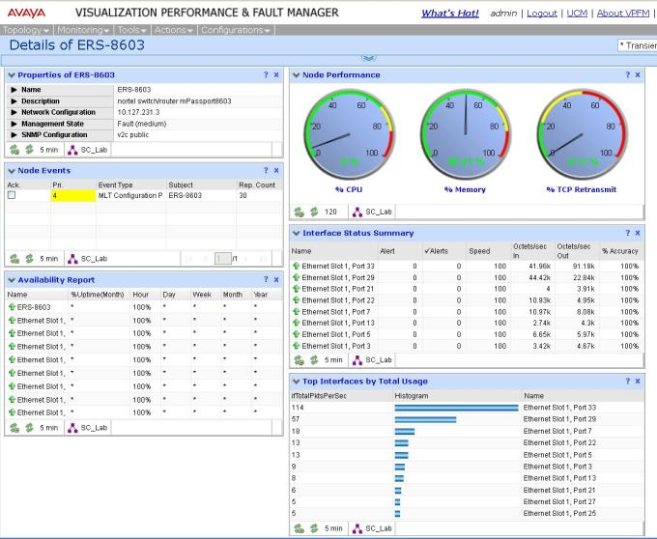
SPB Performance Metrics in VPFM
Multiple KPI gauges, Interface summary for device
on a single dashboard page.
Availability and Event dashlets specific to Avaya Networking

Slide 50


Thank You!
Don R Rumford, APSS, APDS
Sr. Consulting Systems Engineer
Avaya Networking Global Solutions
drumford@avaya.com

Slide 51

Be sure to tweet your feedback on this presentation
BEST OF ATF SPEAKER AND TEAM AWARD
#AvayaATF
Winners will be announced at closing of event

Slide 52
© 2014 Avaya Inc. Avaya – Confidential & Proprietary
Do not duplicate, publish or distribute further without the express written permission of Avaya.

